Slide 1
Intellectual Property Overview
Jessica A. Keesee
Meunier Carlin & Curfman

Slide 2
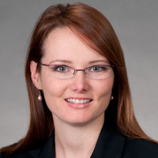
Jessica A. Keesee
Of Counsel
Meunier Carlin & Curfman, LLC
http://www.mcciplaw.com/
jkeesee@mcciplaw.com
Previous:
King and Spalding, Attorney
Finnegan, Henderson, Farabow, Garrett & Dunner LLP, Attorney
Center for Disease Control and Prevention - Technology Transfer Office, Legal Clerk
Elekta, Medical Facilities Design Engineer
Georgia State University, JD 2009
Georgia Tech, ME 2001

Slide 3
Why should you care about IP?
Engineers/scientists generate and use IP
Companies leverage IP
Entrepreneurs often rely on IP for funding
IP careers
Notes:
Engineering Jobs
Many companies offer monetary awards for patents
You may be asked to support patent process
You may need to protect IP used at your job – inventions before application filed, trade secrets
Business
Competitive tool – offensive and defensive
Business generator
Entrepreneurs
Venture capitalists always want to know about a start-up’s IP position
IP Careers
Licensing executive (school or enterprise)
Technical advisor at a law firm
Patent Agent
IP Attorney

Slide 4
Why should you care about IP?
A patent can be:
    Used to gain entry into, and deter others from, a market
    Used as a marketing tool to promote unique aspects of a product
    Assert/enforce rights against an infringer or competitor
    Used as collateral to obtain funding
    Create revenue –sell or license like other property
Notes:
Engineering Jobs
Many companies offer monetary awards for patents
You may be asked to support patent process
You may need to protect IP used at your job – inventions before application filed, trade secrets
Business
Competitive tool – offensive and defensive
Business generator
Entrepreneurs
Venture capitalists always want to know about a start-up’s IP position
IP Careers
Licensing executive (school or enterprise)
Technical advisor at a law firm
Patent Agent
IP Attorney

Slide 5
Types of Intellectual Property
 | What’s Protected? | Examples | Protection lasts for:
Utility Patent | Process, machine, article of manufacture, composition | iPhone, FitBit, | 20 years
Design Patent | Ornamental design (non functional) of article of manufacture | Shape/design of an iPhone (even icons) | 14 years
Copyright | Books, photos, music, art, graphic images, video, film, architecture, computer programs | Beyonce’s Formation (music, video) | Life of the author plus 70 years (or for some works 95 years from first publication)
Trademark | Word, symbol, logo, design, or slogan that identifies and distinguishes products or services | “GOOGLE” logo “What can brown do for you” | As long as used in connection with goods or services
Trade Secret | Formula, method, device or complications of information which is confidential and gives business an advantage | Coca-cola formula | As long as information remains confidential

Slide 6

Patents
The grant of a property right to an inventor
  Right to exclude others from making, using, selling, offering for sale or importing the claimed invention
  Limited term
  Territorial: protection only in territory that granted patent,
  not world-wide patent
Quid Pro Quo
  Inventor discloses the invention
  Time-limited monopoly
Notes:
Article I, Section 8, cl. 8:
Congress shall have the power…..to promote the progress of science and useful arts, by securing for limited times to authors and inventors the exclusive right to their respective writings and discoveries
Congress enacts laws that specify the subject matter for which a patent may be obtained and the conditions for patentability
The invention must be:
Useful, Novel, Non-obvious, Not disclosed to the public more than one year prior to application filing.
Utility patents:
Process, Machine, Article of manufacture, Composition of matter, New and useful improvement thereof;
Design patents:
New, original, and ornamental design for an article of manufacture;
Plant patents:
distinct and new variety of plant.
Not Patentable
Obvious variations of known technology
Abstract ideas
Physical phenomena
Laws of nature
Inventions that do not work
Life of a Patent
First to File vs. First to Invent
Utility and Plant: 20 years from application filing
Design: 14 years from patent grant

Slide 7
Why get a patent?
A patent can be:
    Used to gain entry into, and deter others from, a market
    Used as a marketing tool to promote unique aspects of a product
    Assert/enforce rights against an infringer or competitor
    Used as collateral to obtain funding
    Create revenue –sell or license like other property

Slide 8
Types of Applications
Utility Patent
Protects how an invention works, functions or is made for 20 years from filing date
Design patents
Protects the way a product looks, the ornamental expression for 15 years from the date of grant
Plant patents
Protects newly invented strains of asexually reproducing flowering plants, fruit trees, and other hybrid plants for 20 years from filing date

Slide 9
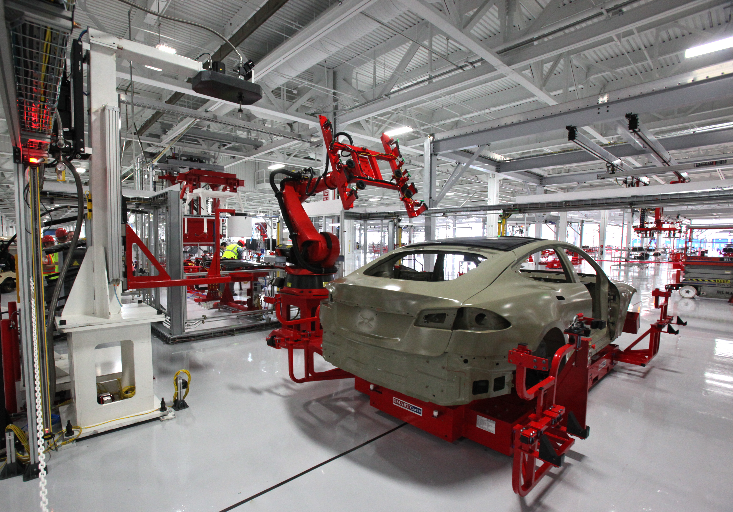
Utility Patent
Protects how an invention works, functions or is made
Process
Machine
Article of Manufacture
Composition of Matter

Slide 10
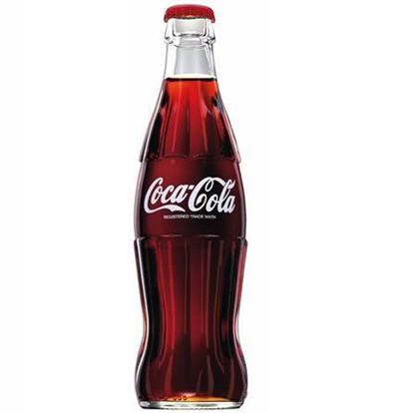
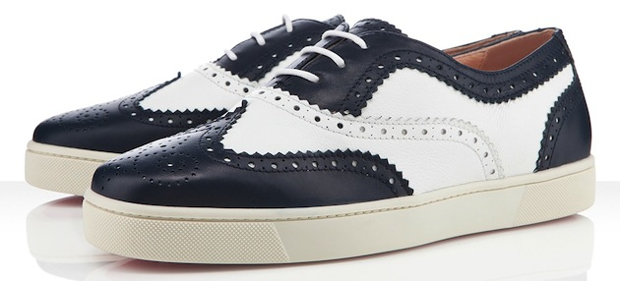
Design Patent
Protects the way a product or article looks, the ornamental expression

Slide 11
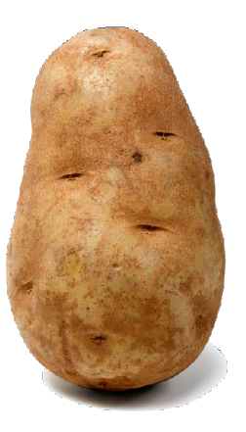
Plant Patent
Protects newly invented strains of asexually reproducing flowering plants, fruit trees, and other hybrid plants.

Slide 12
Provisional Patent Applications
  Place holder application - used to establish priority date for material disclosed
    Priority date = date filed
  Not published unless converted to a non-provisional
  1 year to convert to non-provisional
  Not examined by the USPTO
  When to file – before public disclosure (conference presentation, poster session, department seminar, sponsors/investors, collaborators, competitors)
  When to file – once have reduced their invention to practice (or have a good plan for how to reduce their invention to practice), but plan to continue working on it over the next year

Slide 13
Parts of a Patent Application
Brief abstract (150 words)
  concise summary of your invention
Drawings (if any)
  Illustrations of the general concept of the invention, specific embodiments, variations, prior/existing technology
Descriptive specification
  “Written description” requirement - clearly convey the information that an applicant regards as the invention
  “Enablement” requirement – invention described in sufficient detail to allow a similarly skilled person to reproduce the invention without undue efforts
Numbered listing of claims
  Define the metes and bounds of the protection offered by the utility patent
  Broad v Indefinite

Slide 14
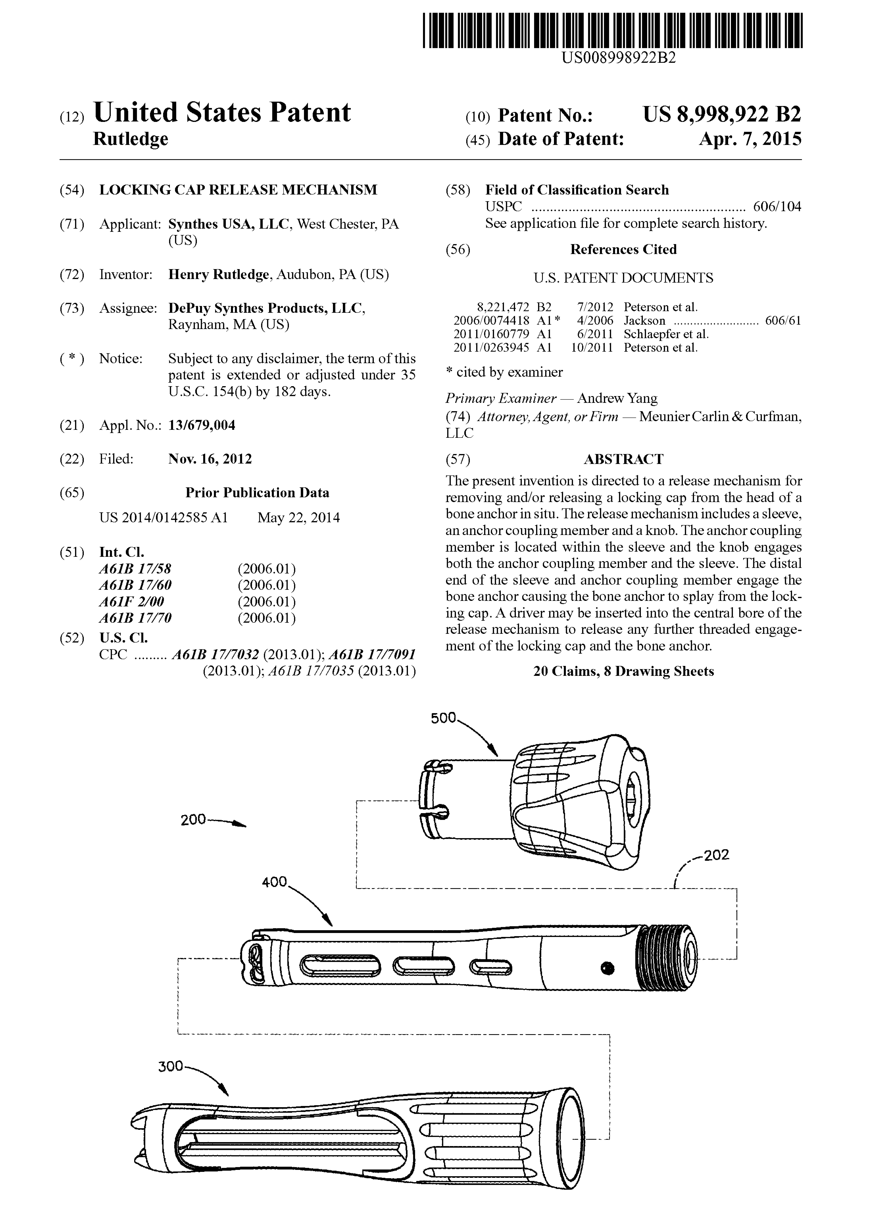
Utility Patent

Slide 15
Utility Patent

Slide 16
Abstract
US 8,998,922 - Locking cap release mechanism
The present invention is directed to a release mechanism for removing and/or releasing a locking cap from the head of a bone anchor in situ. The release mechanism includes a sleeve, an anchor coupling member and a knob. The anchor coupling member is located within the sleeve and the knob engages both the anchor coupling member and the sleeve. The distal end of the sleeve and anchor coupling member engage the bone anchor causing the bone anchor to splay from the locking cap. A driver may be inserted into the central bore of the release mechanism to release any further threaded engagement of the locking cap and the bone anchor.

Slide 17
Drawings

Slide 18
Description

Slide 19
Claims are Key
Protection is limited to what is claimed
During prosecution, claims are searched, may be rejected, amended, and allowed
Specification may include numerous embodiments and elements
  Only subject matter claimed is afforded protection
Examiner works with the Applicant to focus the claims on novel aspects of the invention
Broadest reasonable interpretation during examination
  Search of invention may extend to unrelated areas

Slide 20
Drafting Patent Claims
Parts of a patent claim:
Preamble
Transitional phrase (e.g., “comprising,” “consisting of”)
Body reciting elements of the invention
1. A {insert title} comprising:
{list the parts one by one} {then explain how each are connected}.

Slide 21
Drafting Patent Claims
1. A {insert title} comprising:
{list the parts one by one} {then explain how each are connected}.
1. A sandwich comprising:
  two pieces of bread,
  peanut butter and jelly,
  wherein the peanut butter is spread on one piece of bread and the jelly is spread on the other piece of bread and then the two pieces of bread are put together so that the peanut butter and jelly are touching.
  2. The sandwich of claim 1 further comprising: bacon, lettuce, tomato and fluff, wherein these ingredients are disposed between the peanut butter and jelly.

Slide 22
Claims
Notes:
Claims are the numbered paragraphs at the end of a patent
Claims establish the “metes and bounds” of a patent. They define the scope of the invention.
Systems or methods that are within the claims infringe.
Systems or methods that are outside the claims do not infringe.

Slide 24
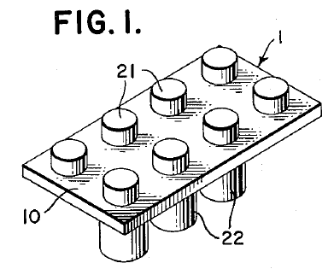
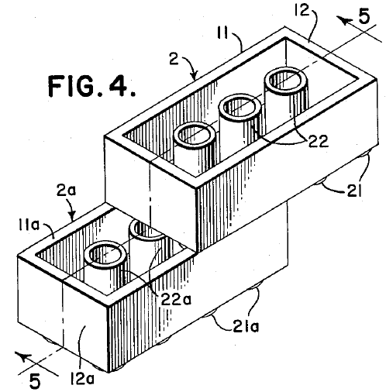

Slide 26
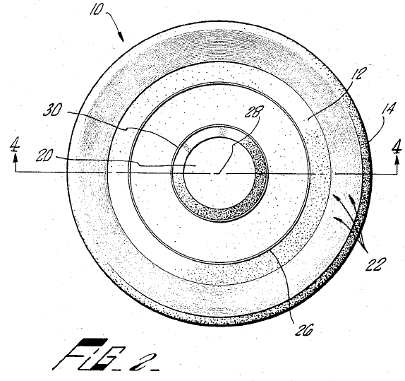

Slide 30
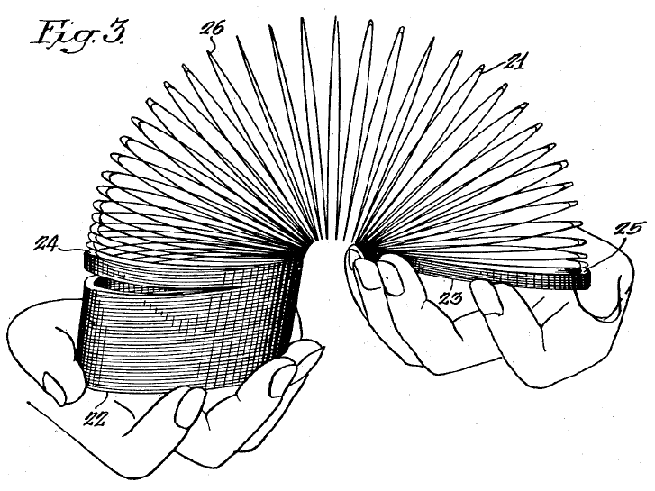

Slide 32
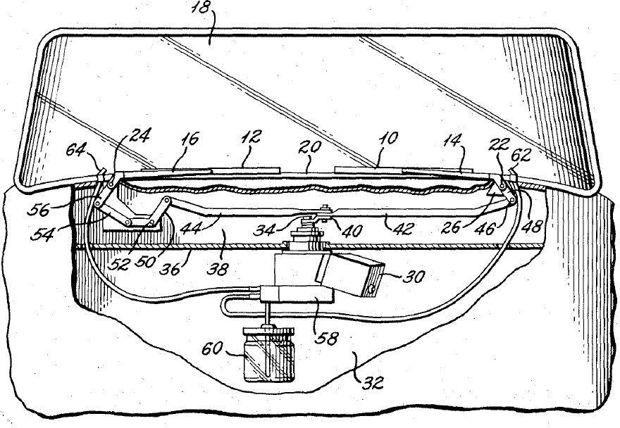
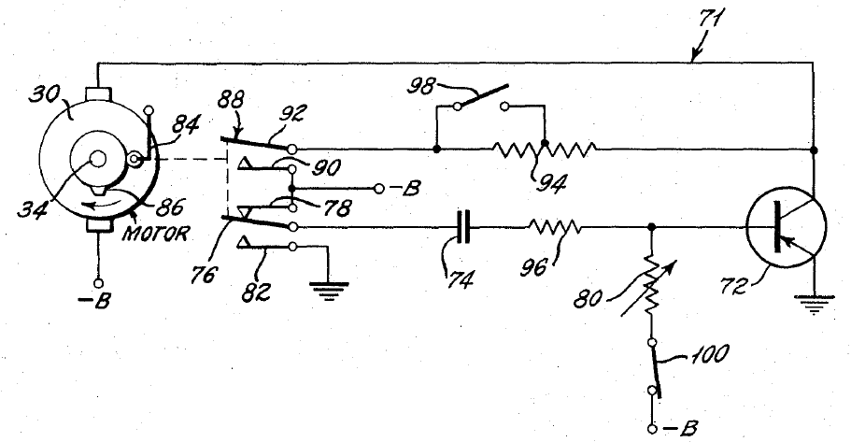

Slide 33
Patent Examination
Application Filed
First Office Action
Final Office Action
Allowance
Issue
Notes:
Timing:
16 months to first Office Action
25 months total pendency
Backlog = 550,000
During Examination:
Evaluate specification and scope of claims
Search for prior art
Determine patentability
Respond to applicant

Slide 34
Requirements for Patentability
Invention must be new (35 USC 102)
  An invention lacks novelty (i.e., is “anticipated”) if:
    each and every element as set forth in the claim is found, either expressly or inherently, in a single prior art reference
Invention must be non-obvious (35 USC 103)
  More than a mere obvious modification of the prior art
    Modification obvious to one of ordinary skill in the art at the time the invention was made
  Can combine the teachings of multiple prior art references

Slide 35
Design Patent
Notes:
Protects the way an article looks, including
its shape and configuration, as well as
surface ornamentation applied to the article

Slide 36
Copyright
Anything creative
Protects “expression” but not “ideas”
  Paintings & Photographs
  Movies, TV Shows, Commercials
  Novels
  Songs
  Computer programs
  Video games
Current Works: life of author + 70 yrs. or 95 yrs. from publication for anonymous author
Notes:
Article I, Section 8, cl. 8:
Congress shall have the power…..
to promote the progress of science and useful arts, by securing for limited times to authors and inventors the exclusive right to their respective writings and discoveries
Congress enacts laws that specify the subject matter for which a copyright may be obtained and the conditions for patentability
Duration -- author’s life (last surviving author) plus an additional 70 years; works made for hire and anonymous and pseudonymous works, the duration of copyright is 95 years from first publication or 120 years from creation, whichever is shorter; foregoing applies to works created on or after January 1, 1978
For a video game, the code, artwork, and sound can all be protected. The code is a literary work, the artwork and sound are audiovisual works.
For a computer program, the author can protect the code and any manuals.

Slide 37
Copyright Does Not Protect
Ideas for games, toys, books, plays, etc.
Common geometric shapes
Lists of ingredients
Program logic
Algorithms
Concepts
Methods
Useful articles (to the extent they do not incorporate independent and separable pictorial, graphic or sculptural features)

Slide 38
How to Obtain a Copyright
Copyright exists from the moment work created
Registration is not required to have rights
Registration is required to bring suit for infringement of U.S. work
Registration is with U.S. Copyright Office (division of Library of Congress)
Rights can also be obtained by assignment
Notes:
Infringement Plaintiff Must Show:
ownership
copying of protectable elements; either by:
direct evidence of copying; or
defendant’s access to plaintiff’s work and substantial similarity of the works
Defenses
Copying of ideas, not expression
Public domain
Implied license
Parody
Fair Use

Slide 39
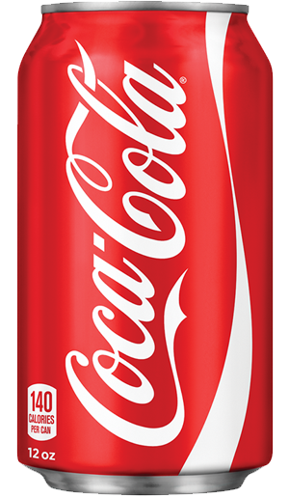




Trademark
Any Word, Name, Symbol, Device (or any combination thereof) used to identify of products and services.
Words -- Brands
Symbols
Distinctive, non-functional features
Product or packaging designs
Sounds
Notes:
A trademark in its broadest sense is any word, name, symbol, design or device, package design or combination of these that identifies a specific product (or service) and distinguishes it from others in the marketplace or trade.
Sounds – ESPN, Yahoo, MGM Lion

Slide 40
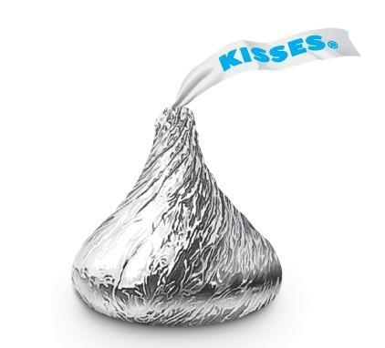


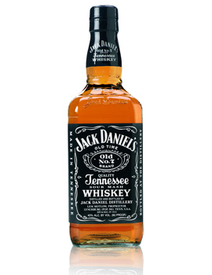
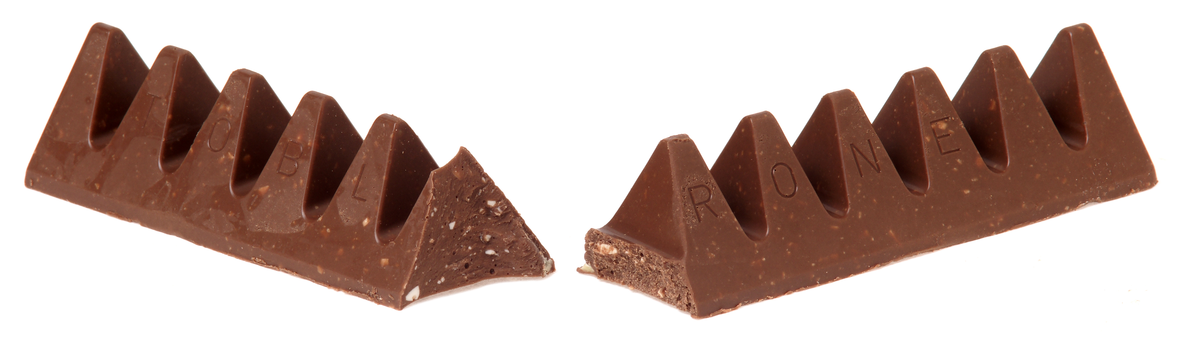
Types of Trademarks
The SHAPES of products may be registered as trademarks

Slide 41
Types of Trademarks
Trademarks can also be PACKAGING for products and services

Slide 42
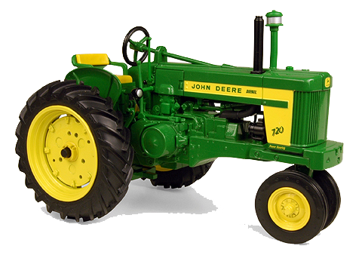

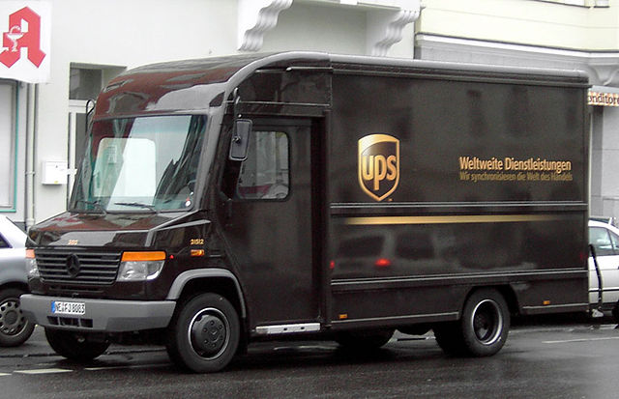
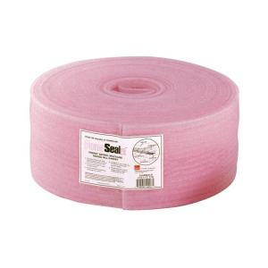
Types of Trademarks
Trademarks can be COLORS

Slide 43

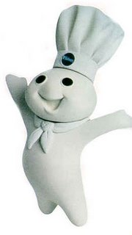

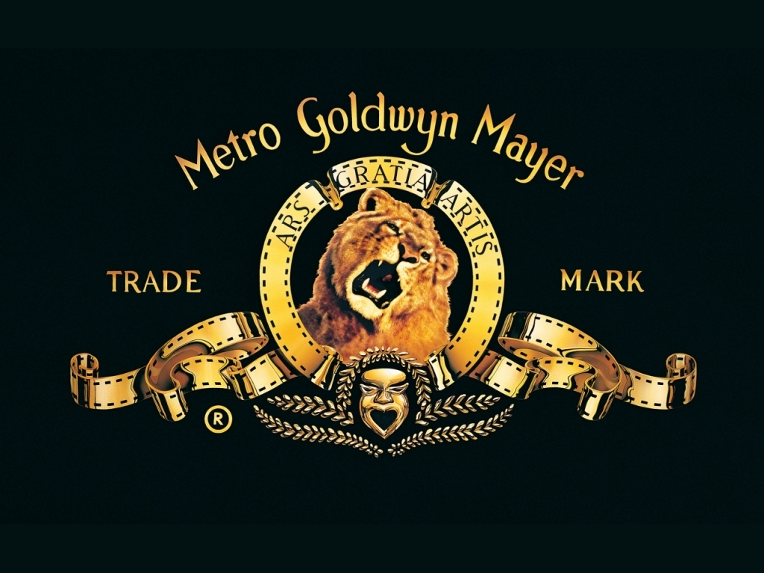

Types of Trademarks
Trademarks can be SOUNDS

Slide 44
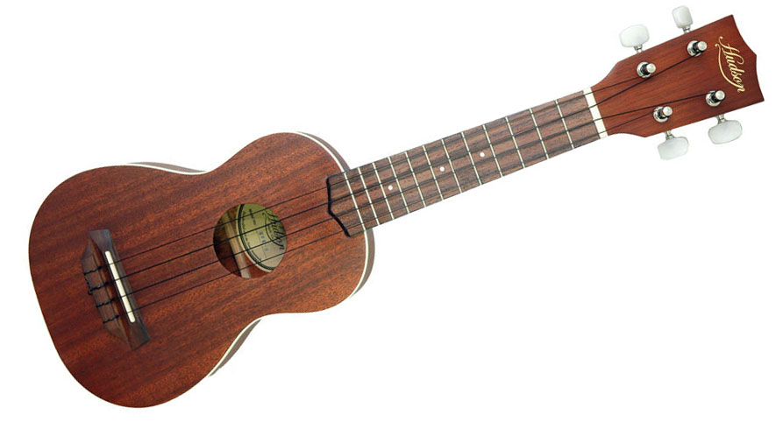

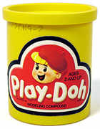
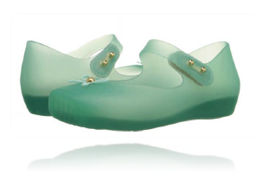
Types of Trademarks
Trademarks can be SMELLS

Slide 45
Strength of a Trademark
Fanciful (made up terms)
  ROLEX watches, EXXON gasoline
Arbitrary (existing words/unrelated goods)
  APPLE computers
Suggestive (takes imagination to link mark to goods)
  COPPERTONE suntan lotion
Descriptive (describes some aspect of the goods)
  RAISIN BRAN cereal, HONEYBAKED ham
  Protection requires establishing secondary meaning
strong
weak
Notes:
Secondary meaning – the public has come to understand the term as indicative of the source of the goods; shown by use in connection with goods, advertising, surveys
What Cannot Be A Trademark
Generic terms
car (as opposed to Ford or Chevrolet)
terms that come to be generic, e.g., aspirin
Functional product features
A product feature is functional and cannot serve as a trademark if
“it is essential to the use or purpose of the article” or
“if it affects the cost or quality of the article”

Slide 46
What makes trademark protection special?
Federally registered trademarks can last FOREVER as long as they are properly and continuously used
Maintenance documents must be timely filed
Contrast – patent protection and copyrights last for only a limited amount of time.

Slide 47
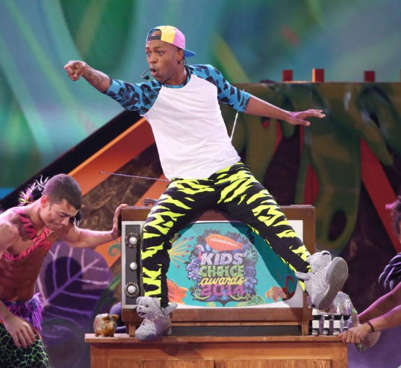
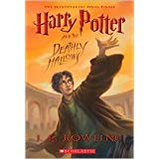
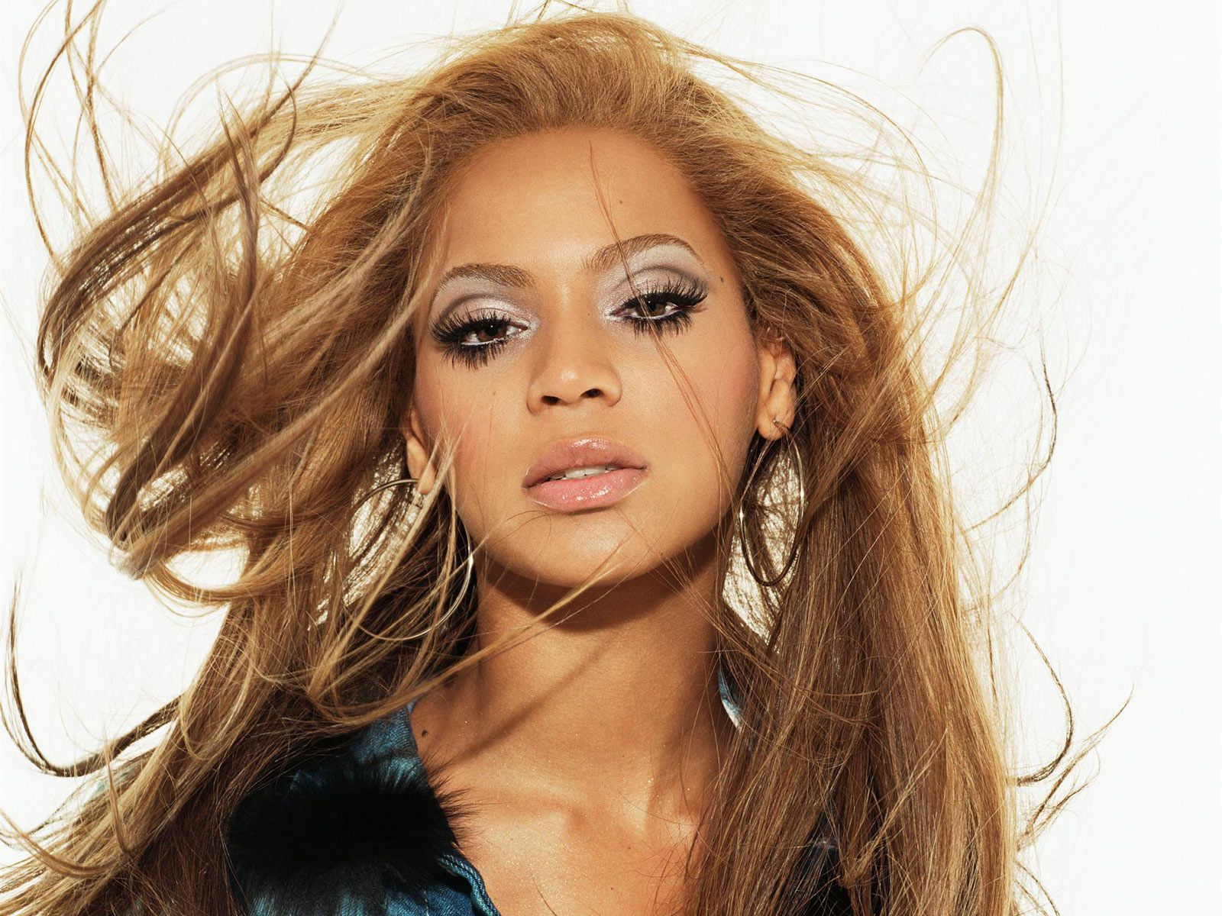
Copyright
Protects “original works of authorship” including literary, dramatic, musical, artistic and other works fixed in a tangible medium
Library of Congress administers registration; USPTO advises the Executive branch on intellectual property issues including copyright
© symbol can be used without registration

Slide 48
Trade Secret
Protects a commercially valuable proprietary information
  Formula, device or compilation of information
Valuable business information that gives a competitive advantage
Duration of protection is potentially infinite
Notes:
Any information that derives economic value from not being generally known or ascertainable
•Can be formulas, patterns, compilations, programs, devices, methods, techniques or processes
•Protection stems from common law dating to the 1800’s
•All states have some sort of trade secret protection
•Most laws based on the Uniform Trade Secrets Act
•In 2016, the Defend Trade Secrets Act was signed by the President

Slide 49
Trade Secrets - Examples
Formula/Recipe
Survey method
Manufacturing process
Customer lists
Design concepts
Computer algorithm
Notes:
In the 1880s, Dr. J.J. Lawrence invented the antiseptic liquid compound Listerine, then licensed its secret formula to J. W. Lambert and the Lambert Pharmacal Co. Warner-Lambert Pharmaceutical Co., successor to Lambert and Lambert Pharmacal, dutifully made royalty payments to the Lawrence family over the next 70 years, despite the fact that Listerine's formula was revealed along the way. But in the 1950s Warner-Lambert (now Pfizer Inc.) decided it had shelled out enough money -- more than $22 million, to be exact -- for a secret formula that wasn't even secret anymore. So it sued for a judgment that it was no longer on the line for the licensing fees. Unfortunately for Pfizer, the courts sided with the Lawrence family, ruling that the contract makes no stipulation about stopping payments if the trade secret is legitimately discovered by others, which it could have done. And anyway, since Pfizer had obtained the formula in the beginning, when it was still secret, it had received a decided marketplace advantage.
About 80 percent of Americans use WD-40 [source: Watson]. The spray, which comes in a familiar blue-and-yellow can with a narrow, red straw stuck into its nozzle for dispensing, was originally developed in 1953 to prevent corrosion. The chemist who invented it sold the formula -- which he'd kept secret -- and his company for $10,000 just a few years later.
Today, WD-40 is used for everything from removing sap, tar and adhesives from various surfaces to cleaning tools and equipment. It's the company's only product, and its secret formula was never patented so competitors could never discover what's in it. The company does reveal what's not in WD-40: "silicone, kerosene, water, wax, graphite, chlorofluorocarbons (CFCs) or any known cancer-causing agents" [source: WD-40].
The revered formula has been sitting in a bank vault for years; it was taken out once when the company changed banks, and again when the company's CEO, armored and riding a horse, brought it out for the company's 50th birthday [source: The Wall Street Journal]. To further protect the formula's secrecy, the company mixes the substance in three different cities around the globe, then passes it on to its manufacturing partners [source: Daily Finance].
In reality, says Cabrini College Assistant Professor of Business Scott Testa,scientists have figured out, for the most part, what's in WD-40. "But some trade secrets are kept secret because from a marketing perspective, there's a certain allure if something's secret," he says. "This is probably more of a marketing exercise than what I'd consider a scientific exercise.
So many people love gooey, chewy Mrs. Fields Chocolate Chip Cookies, it's only natural they'd want the recipe. But it's a secret, says the company. Bakers have long tried to figure out the recipe themselves through a process called reverse engineering, but most want the real thing.
The intrigue surrounding the recipe became so intense, it gave birth to a popular urban legend, which goes like this: A woman and her daughter ask a clerk if they can have the cookie recipe. The clerk says sure, but it costs "two fifty." The woman hands over her credit card, gets the recipe, then later realizes she's been charged $250, not $2.50, as she'd assumed. When she calls the store to have the charge removed, she's turned down because she's already seen the secret recipe. So the woman e-mails it to everyone she knows, asking them to pass it on so it will lose its value [source: Watson].
"The secretness of the recipe helped to build the brand's early buzz, and got people to try the cookies ... and then tell their friends," says Jim Joseph, author of "The Experience Effect." "It's a great example of a trade secret driving the success of the brand.”
It's every writer's dream to get his or her novel on The New York Times Best-Seller list, the most influential such list in America, which dates back to 1942. So how do you do it? No one really knows. The New York Times won't reveal what constitutes a best-seller, saying its methodology is a trade secret. We do know the newspaper asks chain bookstores, independent bookstores and wholesalers about their sales figures, but that's about it. The reason for the secrecy is supposedly that if the system was known, publishers could play around with sales data to their advantage.
It should be a relatively easy formula: A book that sells 'x' number of copies in a week or month or year is a best-seller. But one book that sells 32,000 copies can be named a best-seller, while another that sells even more is not. Times employees skirt around the issue, saying there are "official" best-sellers and "unofficial" best-sellers [source: Gould].
This trade secret has gotten the company into legal battles at times. In 1983, William Peter Blatty, author of "Exorcist,"unsuccessfully sued the newspaper for $9 million, saying that amount equaled his lost revenue when the paper didn't add his novel "Legion" to its best-seller list.
The most infamous of all trade secrets in America is the recipe for Coca-Cola's Coke. At the end of the 19th century, Coca-Cola had a choice: Patent the recipe for its popular soft drink, which would mean disclosing its ingredients, or brand it a trade secret and keep things under wraps. Execs chose the latter route. Part of the reason might have been because the recipe contained a small amount of cocaine, a fact the company may have wanted to keep to itself. Whatever the reason, its decision has had repercussions.
Since its invention, there have been numerous rumors about Coke's ingredients, including one that said the recipe contained bugs. Another rumor says two employees each know just half of the recipe, and only two people know the combination to the safe where it's stored. "Over the years, the rumors have taken a life of their own," says Scott Testa, assistant professor of business at Cabrini College.
Despite its stringent security measures, in 2006 a Coca-Cola employee and two accomplices tried to sell the Coke recipe to Pepsi, says Testa. To its credit, Pepsi promptly notified Coke officials, and the group was busted.

Slide 50

Ways to lose a trade secret:
  Owner or owner-authorized disclosure
  Reverse engineering
  Independent development
  Failure to take reasonable efforts to preserve confidentiality

Slide 51
Common IP Issues Faced by University Students, Researchers, Faculty
Risks of various disclosure activities
  Public disclosure by an inventor may bar patentability
Identifying inventors

Slide 52
Public Disclosure
Legal standard governed by 35 USC 102
  “A person shall be entitled to a patent unless (a) the claimed invention was patented, described in a printed publication, or in public use, on sale, or otherwise available to the public before the effective filing date of the claimed invention”
Publically available if can be found by interested persons using reasonable diligence
Not necessary to show that anyone actually inspected the reference
1 year grace period
Notes:
Balance the traditional mission to publicly disseminate knowledge vs protecting and commercializing university inventions
public use bar
invention is in public use before the critical date and is ready for patenting
Test for the public use prong includes the nature of the activity that occurred in public, public access to the use, confidentiality obligations imposed on members of the public who observed the use, and commercial exploitation.

Slide 53
Public Disclosure
Disclosure to a single person can be “public” if it is done so without limitation or restriction
  Recommend: confidentiality/nondisclosure agreements, anti-copying software, disclaimers
“reasonable expectation of confidentiality” only protects the initial disclosure by the inventor to the confidential party
Notes:
confidentiality agreement
Use of protective measures -- nondisclosure agreements, anti-copying software or even simple disclaimers – court can determine there was a reasonable expectation on the part of the inventor that the displayed information will not be copied

Slide 54
Public Disclosure - Europe
Legal standard governed by Article 54 of the European Patent Convention
  Covers “everything made available to the public”
  Conditions:
    Relevant disclosure must be available to at least one member of the public;
    Disclosure has to actually teach the information to be used in evaluation of patentability; and
    Technical teaching of the prior art must be enabled
No grace period
Notes:
Relevant disclosure must be available to at least one member of the public
Disclosure must be accessible AND non-confidential
information disclosed to a third party under conditions of secrecy, either expressly or impliedly, is generally not “available to the public”

Slide 55
Examples of Public Disclosure
Submitted Manuscripts and Online Publications
  Manuscripts submitted to peer-reviewed journals are usually treated with confidentiality by the journal’s editors and reviewers until publication
  Online publication usually occurs before printed publication
Theses and Dissertations
  Generally sufficiently accessible to the public once it is indexed and shelved in a library
  Accessible even where access to the library is restricted
  Some schools embargo a thesis/dissertation for a limited time
Notes:
Submitted Manuscripts and Online Publications
important to determine the exact dates for both online and printed publication, and then to file a patent application before publication occurs.
If publication has already occurred, then a patent application should be filed as soon as possible within the U.S. grace period.
Theses and Dissertations
Scientific Meeting Presentations
Grant Applications
Collaborations

Slide 56
Examples of Public Disclosure
Scientific Meeting Presentations
  Abstracts, posters, slides, oral presentations, and in casual conversation with other attendees
  Meeting abstracts made available to meeting attendees one or two months before the meeting
Grant Applications
  Grant applications submitted to private foundations or federal agencies are generally held in confidence while under review
  Once (federal) grant is funded - certain details, such as the project title, principle investigator, amount of reward and the grant abstract are generally made available to the public

Slide 57
Examples of Public Disclosure
Collaborations
  Presentations and informal conversations
  Professional norms/codes of practice can support expectations of confidentiality without any formal agreements in place
  Industry-sponsored research
    Communications with industry may lack implicit expectations of confidentiality and require formal agreements with clear confidentiality provisions
  Inventor collaboration with student/faculty who receives an industry-sponsored research agreement
    Inventor may have a reasonable expectation of confidentiality based on professional norms but colleague may have a contractual relationship with an industry partner
    What if the colleague maintains an academic appointment as well as employment or directorships at private companies?
  Recommend: confidentiality agreements, file patent application early (before collaboration), establish expectation of confidentiality (e.g., mark communication confidential, communication expectation)

Slide 58
Identifying Inventors
An inventor is anyone who “invents” a process, machine, manufacture, composition of matter, or a new and useful improvement thereof that is claimed in a patent
Determined on a claim-by-claim basis
  compare the contributions of asserted inventors with the subject matter of the properly construed claims
Only those individuals who participate in the conception of an invention may be named as true inventors
  Conception complete when only ordinary skill would be necessary to reduce the invention to practice, without extensive research or experimentation
  Those who offered suggestions and ideas leading to the operative invention may be inventors because they contributed to the conception
“Author” and “Inventor” are not synonymous
Notes:
Conception:
inventor must form a definite and permanent idea of the complete and operable invention to establish conception

Slide 59
Identifying Inventors
Generally NOT an inventor when:
  Contributing an obvious element or general knowledge
  Merely suggesting a desired result or outcome without providing the means to accomplish the same
  Following the instructions of the conceivers
  Merely supplying a known component or starting material
  Merely refining or perfecting another's design or making only superficial changes

Slide 60
Resources at Tech
Intellectual Property Career Showcase
  Fall Semester
  http://www.ipcareershowcase.com/
GT Legal Buzz Office hours
  TSRB 112 (BuzzCard required to enter building)
  Year round
Intellectual Property Student Organization
  ORGSYNC
  https://www.facebook.com/gtipso/
  gatechIPSO@gmail.com

