Slide 2
USPTO Office of
Innovation Development
Patent Overview
Zandra Smith
Pro Se Assistance Center Coordinator

Slide 3
Objectives
Overview of Intellectual Property (IP)
Process of Filing a Patent Application
Resources
Notes:
This is meant as education at the University level and not as legal advice. If you have a specific (and hopefully valuable) invention, you ought to get appropriate legal advice from someone representing your interests.
The US Constitution doesn’t mandate that patents and copyrights exist, but it gives Congress the authority to enact legislation. Congress took advantage of that right away - the first patent act and first copyright act were enacted before Rhode Island joined the Union (April 1790 vs. May 1790)
Both copyrights and patents are predicated on promoting progress – not on the moral right of the inventor or author. The constitutional framework presupposes improvements in human knowledge – in the public domain – after a period of exclusivity for the author or inventor.
If you look at the structure of this clause, it goes “science->authors->writings” and “useful arts->inventors->discoveries”. Over the past two centuries the meaning of “art” and “science” in casual conversation have largely switched, except for terms like “state of the art”.
The 1870 Trademark act was drafted based on the patent and copyright clause and not the commerce clause and was held to be unconstitutional for that reason in The Trade-Mark Cases, 100 U.S. 82 (1879)
Trademarks are not exclusively federal since the states have the authority to regulate commerce in their jurisdiction – Congress gets interstate commerce, but the states still have intrastate commerce.

Slide 4

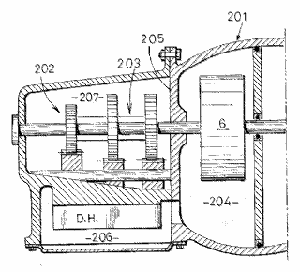
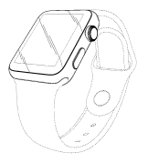
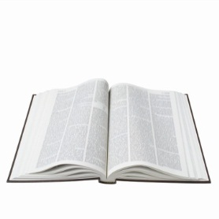


Overview of Intellectual Property
 | Utility/Plant Patent | Design Patent | Trade Secrets | Copyrights | Trademarks
What is protected | Inventions – Process, machine, manufacture, or composition of matter | Ornamental characteristics embodied in, or applied to, an article of manufacture | Commercially valuable information (e.g., formulas, techniques, processes) | Art, in an all-encompassing sense – original works fixed in a tangible medium | Marks in commerce that indicate the source or origin of goods or services
Protects Against… | Making, using, selling, offering for sale, and importing into the U.S. | Making, using, selling, offering for sale, and importing into the U.S. | Stealing or unauthorized disclosure | Copying, performing, displaying, and creating derivative works | Using a mark in a way that causes likelihood of confusion
Endures until… | Generally, from the patent grant date to 20 years from the earliest effective U.S. filing date | 15 years from issuance of patent for applications filed on or after May 13, 2015 | Publicly disclosed | The life of the author + 70 years | Abandoned or loss of distinctiveness or secondary meaning
Rights of Independent Third Party Creators | None | None | Full | Full | None
Examples |  |  | Coca Cola formula

Slide 5
Overview of IP: Types
Trademarks
  Protects marks in commerce that indicate the source or origin of goods or services
  Source: Federal, State, and Common Law
Copyrights
  Protects original (art) works fixed in a tangible medium
  Source: U.S. Const., Art. I, Sec. 8
Trade Secrets
  Protects commercially valuable information
  Source: State and Common law
Patents
  Protects inventions
  Source: U.S. Const., Art. I, Sec. 8
Notes:
The US Constitution doesn’t mandate that patents and copyrights exist, but it gives Congress the authority to enact legislation. Congress took advantage of that right away - the first patent act and first copyright act were enacted before Rhode Island joined the Union (April 1790 vs. May 1790)
Both copyrights and patents are predicated on promoting progress – not on the moral right of the inventor or author. The constitutional framework presupposes improvements in human knowledge – in the public domain – after a period of exclusivity for the author or inventor.
If you look at the structure of this clause, it goes “science->authors->writings” and “useful arts->inventors->discoveries”. Over the past two centuries the meaning of “art” and “science” in casual conversation have largely switched, except for terms like “state of the art”.
The 1870 Trademark act was drafted based on the patent and copyright clause and not the commerce clause and was held to be unconstitutional for that reason in The Trade-Mark Cases, 100 U.S. 82 (1879)
Trademarks are not exclusively federal since the states have the authority to regulate commerce in their jurisdiction – Congress gets interstate commerce, but the states still have intrastate commerce.

Slide 6
Overview of IP: Trademarks
Key Purposes:
  Allow consumers to identify the source or producer of different products and services – helps their buying decisions
  Encourage trademark owners to provide goods and services of consistent quality and to build goodwill in the trademark
Notes:
A trademark is a brand name. A trademark or service mark includes any word, name, symbol, device, sound, color, or any combination, used or intended to be used to identify and distinguish the goods/services of one seller or provider from those of others, and to indicate the source of the goods/services.
Trademarks exist at both the federal and state level, and largely serve to prevent confusion on the part of the customer. A company that owns a trademark doesn’t own the right to control how people talk about its products – it has rights in order to prevent counterfeiting and confusingly similar names.
The opposite of a trademark is a generic term, which indicates the type of a product independent of the source or manufacturer. Nobody owns the generic word “car” – but somebody owns “Ford”, “Volkswagen” or “Tesla” as a name indicating the source/manufacturer of cars.

Slide 7



Federally Registered Trademarks
Right to enforce nationally and bring legal action in federal courts
Use of federal Trademark registration symbol ®
Right to record mark with Customs
Serve as basis for foreign filing
Publication in U.S. Trademark database
®
guess the mark
®
Notes:
Registration of a trademark at the USPTO is not required, but it brings several benefits. A significant benefit is nationwide protection – protection at the state level depends on use and enforcement in each state.
While you can file an “intent to use” application at the USPTO, trademark owners need to use the mark in commerce in order to retain protection. You can’t just think up a great name for a product and own it forever without actually using it.
“Record mark with customs” is significant because it gives a right to block importation and in some instances seize counterfeit goods.

Slide 8

Overview of IP: Registered Trademarks
Word Mark: North Carolina State University
Serial Number 2932440

Slide 9



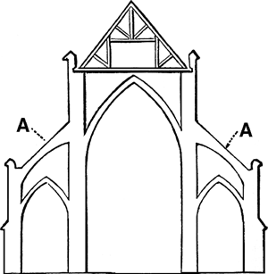
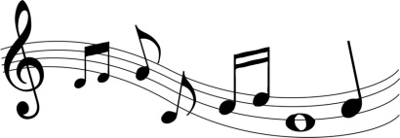
Overview of IP: Copyright
  Protects “original works of authorship” including literary, dramatic, musical, artistic and other works fixed in a tangible medium
  Library of Congress administers registration; USPTO advises the Executive branch on intellectual property issues including copyright
  © symbol can be used without registration
Notes:
An other IP area authorized by Article I, section 8 is Copyright. While the Copyright Office is part of the Library of Congress the Undersecretary of Commerce for Intellectual Property has oversight authority and advises on Copyrights.
Copyrights protect those IP issues that deal with original works of authorship such as books, plays, movies, the recording industry (DVDs, musical scores, sheet music, etc), artistic works (painting, drawing, photography etc), computer programs and others. The term of a copyright is good for the life of the person who developed the IP plus 70 years. This time was extended from 50 years to 70 years in the Copyright Term Extension Act of 1998.
Anything you write down, paint, photograph etc is copyrighted, but it needs to be protected by registration with the Library of Congress to gain strong protection under the law.

Slide 10

Copyright Registration
Copyright protection is secured automatically upon creation (fixation)
  A work is “created” when it is fixed in a copy for the first time
No publication or registration is required
  There are, however, advantages to registration
Notes:
Benefits of registration:
Registration establishes a public record of the copyright claim.
Before an infringement suit may be filed in court, registration is necessary for works of U. S. origin.
If made before or within five years of publication, registration will establish prima facie evidence in court of the validity of the copyright and of the facts stated in the certificate.
If registration is made within three months after publication of the work or prior to an infringement of the work, statutory damages and attorney’s fees will be available to the copyright owner in court actions. Otherwise, only an award of actual damages and profits is available to the copyright owner.

Slide 11

Overview of IP: Trade Secrets
Any information that derives economic value from not being generally known or ascertainable
Can be formulas, patterns, compilations, programs, devices, methods, techniques or processes
Protection stems from common law dating to the 1800’s
All states have some sort of trade secret protection
Most laws based on the Uniform Trade Secrets Act
In 2014 Congress considered, but did not pass, federal versions of the UTSA
Notes:
11
Trade secret protection stems from common law of the 1800s, but most states use the Uniform Trade Secrets Act to form the basis of their laws. In contrast to patents, trademarks and copyrights being regulated by federal law, trade secrets are primarily maintained through state laws.
Examples of Famous Trade Secrets: Coca-cola recipe, KFC recipe, Big Mac special sauce, Krispy Kreme doughnut recipe, Twinkies recipe, WD-40 formula, Listerine (interesting story with this one), and NY Times Best-Seller List (source: http://money.howstuffworks.com/10-trade-secrets.htm#page=1)
Trade secret is any information that provides economic value, that is not in the public domain and that has been reasonably kept secret. Certain factors need to be addressed to determine if a trade secret exists:
1- extent to which information is known outside a business
2- extent to which information is know inside a business
3- precautions take to guard the secrecy of the information
4- savings effected and value in having the information against competitors
5- amount of money and effort expended in obtaining and developing the information; and
6- amount of time and expense for other to acquire and duplicate the information.
Google’s algorithm for its search engine is also a very valuable trade secret. Everyone knows that Google uses an algorithm that ranks websites based on many factors including inbound links, page rank, relevant text, anchor tags, etc. However, no one except perhaps Larry Page and Sergey Brin, the founders of Google, know the exact algorithm for the Google search engine

Slide 12
Why are Trade Secrets useful?
Protects commercially valuable proprietary information, e.g., formulas, recipes, or business information that gives a competitive advantage
    Customer lists
    Product formulations
    Search algorithms
Trade Secrets are not generally known and must be subject to reasonable efforts to preserve confidentiality
No set term for protection

Slide 13

How to Lose a Trade Secret?
Failure to take adequate steps to prevent disclosure
Owner or owner-authorized disclosure
Reverse engineering
Independent development
Notes:
Trade secrets are good for as long as they are secret or not discovered. It may be possible for someone, without insider knowledge, to reverse engineer and discover the trade secret.
Is it therefore better to keep innovations as trade secrets? Remember the constitutional purpose for patents is “to promote the progress of science and useful arts”. If we keep all things secret the progress of the useful arts may be stilled or slowed. It is a business decision and there are times when the use of trade secrets are proved to be warranted, such as the Coca-Cola recipe or the KFC recipe.

Slide 14
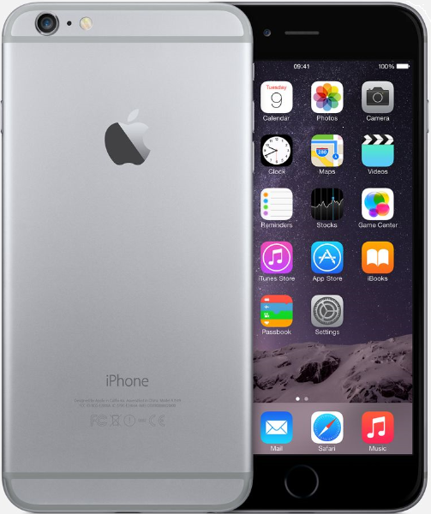
Overview of IP: A Mobile Phone
Trademarks:
Made by “Apple” (logo)
Product “iPhone”
Software “iOS", “Safari”
Patents:
Semiconductor circuits
Touch Screen
Battery/Power Control
Antenna
Speaker
Device Housing
Copyrights:
Software code
Instruction manual
Ringtone
Trade secrets:
???
Designs (some of them patented):
Form of overall phone
Placement of button & speaker
Color pattern of trim
Surface finish
© Apple
Notes:
A single commercial product may be covered (in different aspects) by multiple patents, trademarks, copyrights, and trade secrets at the same time. A good example of this is the mobile phone.
Possible Trade Secret example: a search algorithm
There was a significant worldwide litigation between Apple and Samsung – over 50 lawsuits in at least 10 countries – over utility and design patents and registered trademarks owned by both sides. The list is of elements that are potentially patentable/trademarkable, not that were at issue in the litigation.

Slide 15
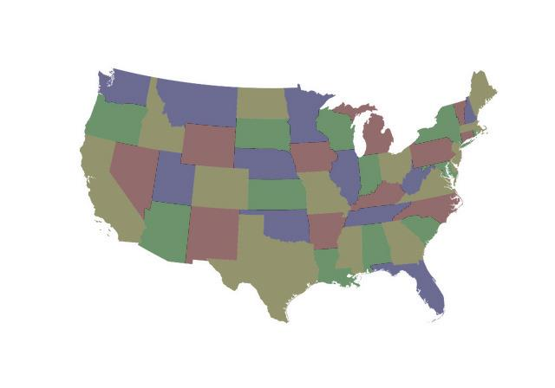
Overview of IP: What is a Patent?
A Property Right
  Right to exclude others from making, using, selling, offering for sale or importing the claimed invention
  Limited term
  Territorial: protection only in territory that granted patent; NO world-wide patent
Government grants the property right in exchange for the disclosure of the invention

Slide 16
The Role of the Patent System
Protect Inventions
Encourage Inventions
Promote commercialization and application of invention
Accelerate the commercialization of invention to the whole society

Slide 17

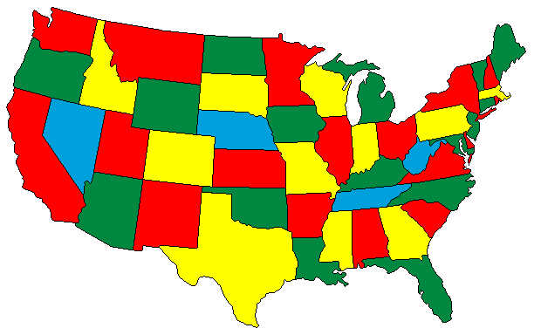
What is a Patent?
A Property Right
  Right to exclude others from making, using, selling, offering for sale or importing the claimed invention
  Limited term
  Territorial: protection only in territory that granted patent; NO world-wide patent
Notes:
Can mention PCT
Copied form IP Basics_CornellTech_25 Nov2014

Slide 18

Why get a Patent?
A patent can:
  Help to gain entry into, and deter
  others from entering into, a market
  Attract investors
  Be used as a marketing tool to promote unique aspects of a product
  Be asserted against an infringer
  Be used as collateral to obtain funding and increase leveraging power
  Create revenue – sell or license like other property
Patents are a form of property that can add value to a company’s assets

Slide 19
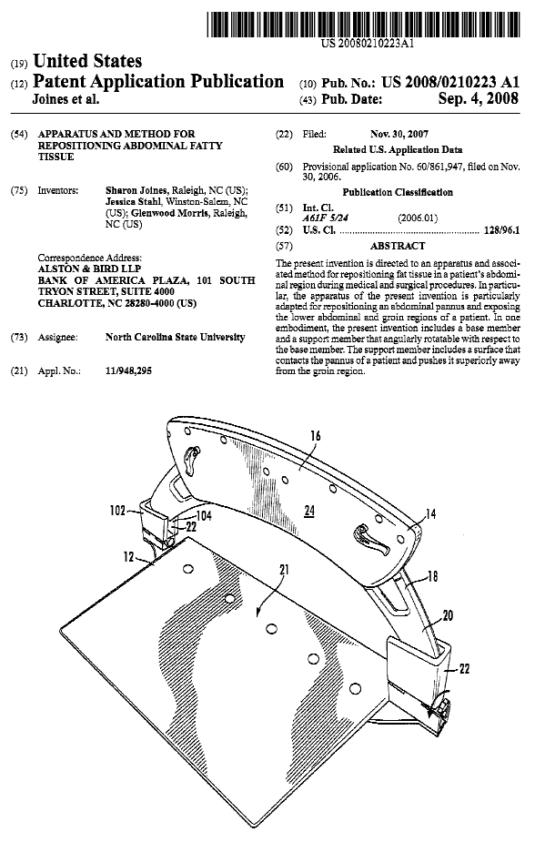
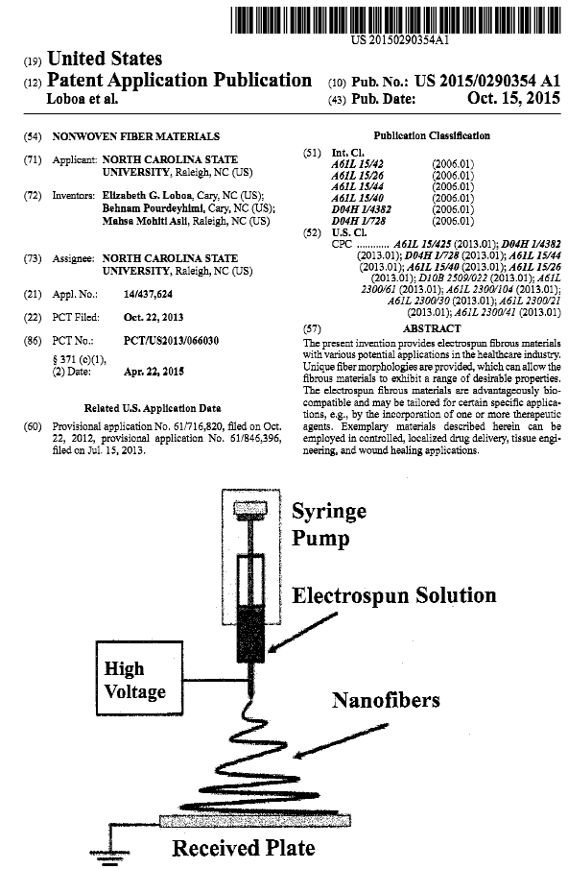
Overview of IP: Registered Trademarks

Slide 20
What happens after I get my patent?
Licensing
Enforcement
More innovation and competition
Administrative Trials
Litigation
Etc…

Slide 21
Patent Examination Process Overview
Appeal
Application is filed
by Inventor
or Assignee
USPTO
Pre-Exam
Amendment and/or argument
EXAMINER
APPLICANT
Rejection and/or objection
Notice of Allowance
Abandonment
USPTO Grants Patent
Notes:
This flowchart shows a simplified version of the patent examination and appeal process. This flow chart can also be used to explain how USPTO performs its duties and functions.
Blue outlines the examination process. Although patent examiners play important roles in the patent examination process, other supporting staff, non-patent examiners, are very important in the patent examination and appeal process. For example, Pre-exam; TSS, etc.
Patent examination often involves multiple Office actions on the merits, and applicant(s) responses. During the patent examination process, examiners at USPTO review the applications on their merits according to the US Patent laws, rules and procedures. If the patent application is found to comply with the US Patent laws, rules and procedures, e.g., the claims are novel and non-obvious, USPTO grants a patent to the applicant.

Slide 22

Pre-filing Decisions
Should I file an application?
  Prior art search
  Business plan – who will buy the invention?
When should I file?
Where should I file?
What type of application(s) to file?
Who should prepare the application(s)?

Slide 23
Provisional Utility Applications
A low-cost way to establish an early effective filing date (priority date) with fewer formalities
A provisional application does NOT issue as a patent, but a later-filed regular application may issue as a patent and benefit from the provisional application filing date
12 month window to file corresponding utility patent application in order to benefit from the priority date of the provisional application
Provisional application is abandoned automatically at 12 months and is not examined
Notes:
There are no design provisional applications. See 35 USC 172: The right of priority provided for by section119(e) shall not apply to designs.

Slide 24
Provisional Utility Applications
File non-provisional utility application
US Patent Granted
Provisional Application
12 months pass, no non-provisional is filed
Abandonment

Slide 25
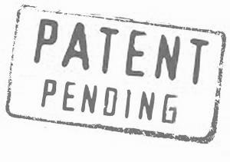
Provisional Utility Applications
Additional benefits of Provisional Applications:
Patent term measured from filing date of subsequent non-provisional application
  Patent term is currently 20 years from the date of filing
  Provides up to an additional 12 months of protection on your invention based on filing of the non-provisional.
Term patent pending allowed to be applied
  Inventors may use term during time period after patent application (Provisional, Non-Provisional, Design, or Plant) has been filed, but before patent has issued
Notes:
*clip art*

Slide 26
Provisional Utility Applications
(MPEP 201.04(b))
Low cost submission to establish filing date
  $130 small entity
  $65 micro entity
For micro entity status, each inventor (and any assignee-applicant) certifies that he/she:
  Qualifies as a small entity (less than 500 employees);
  Has not been named as an inventor on more than 4 previously filed patent applications;
  Did not, in calendar year preceding the calendar year in which the applicable fee is paid, have a gross income exceeding 3 times median household income; and
  Has not assigned, granted, or conveyed (and is not under obligation to do so) a license or other ownership interest in the application concerned to an entity that, in calendar year preceding the calendar year in which applicable fee is paid, had a gross income exceeding 3 times the median household income.

Slide 27
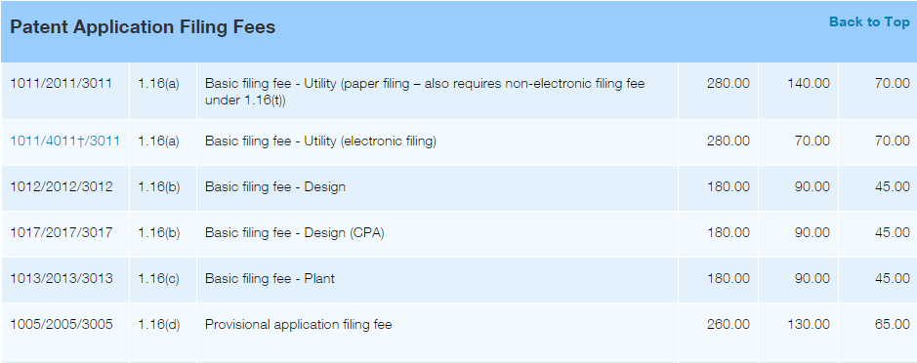
Current USPTO Fee Schedule
http://www.uspto.gov/learning-and-resources/fees-and-payment/uspto-fee-schedule
Notes:
As of June 29, 2016

Slide 28


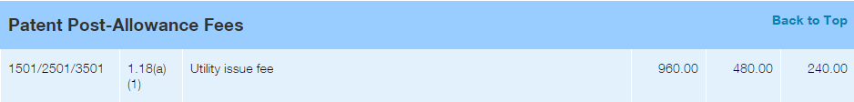
Current USPTO Fee Schedule
http://www.uspto.gov/learning-and-resources/fees-and-payment/uspto-fee-schedule

Slide 29
Provisional Utility Applications
(MPEP 201.04(b))
Automatic abandonment after one year
Inventor given time to investigate market potential / make improvements
  Be careful - too much change could result in loss of provisional filing date
  Many inventors file multiple provisional applications during the 1-year pendency of the first filed provisional to include improvements
Also provide time to obtain counsel if desired
No patent issues—not examined

Slide 30

Provisional Utility Applications
Simplified filing requirements
Items required:
  Specification - CLEAR DESCRIPTION - in compliance with 35 USC 112, Paragraph (a)
    enablement, written description, best mode
  Drawings (needed in almost all cases)
  Filing fees
  Cover Sheet identifying Provisional Application

Slide 31
Provisional Utility Applications
Use of USPTO cover sheet [PTO/SB/16] encouraged:
Provides a clear indication that applicant is filing a provisional application.
  Inventor name(s)
  Inventor residence(s)
  Title of the invention
  Correspondence address
  Attorney information (if any)
  U.S. government interest (if any)

Slide 32
Electronic Filing Information
Electronic Filing – EFS-Web Guidance and Resources
http://www.uspto.gov/patents-application-process/applying-online/efs-web-guidance-and-resources
EFS Sandbox
http://www.uspto.gov/ebc/portal/sandbox/efs0-3-0.htm
EFS – Process of filing online
http://www.uspto.gov/patents-application-process/applying-online/efs-web-guidance-and-resources
Fillable form – Provisional Application Cover Sheet
http://www.uspto.gov/sites/default/files/forms/ProvisionalSB.pdf

Slide 33
Where do you go from here?
Provisional Applications – As Basis for Priority
Domestic Priority
  For non-provisional applications
Foreign Priority
  Foreign Applications can claim benefit of Provisional Application filing date if filed within 12 months of the Provisional filing date under Paris Convention Article 4
  Patent Cooperation Treaty (PCT) application can claim priority to US Provisional Application

Slide 34

Tools and Resources
The Office has a number of tools and resources to help applicants throughout the patent application filing process and beyond

Slide 35
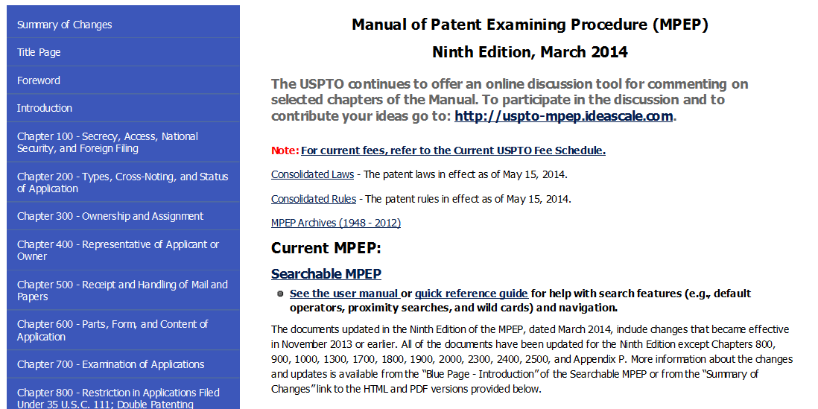
Manual of Patent Examining Procedure (MPEP)
http://www.uspto.gov/web/offices/pac/mpep/index.html

Slide 36

Inventors Assistance Center
1-800-786-9199
Staffed by experienced former USPTO supervisors and examiners
Will answer general questions about patent examination and procedures
Can assist you in filling out patent forms

Slide 37
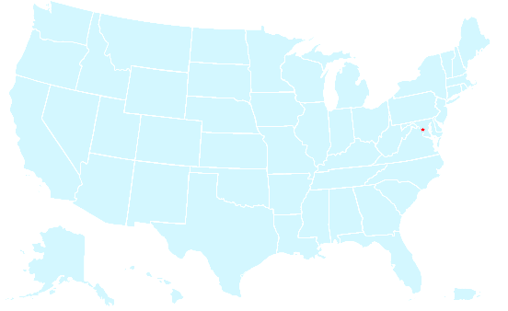
Patent Pro Bono Program
Nationwide program to assist financially under-resourced independent inventors and small businesses
Provides access to free legal assistance by registered patent attorneys
Notes:
Text taken from http://www.uspto.gov/patents-getting-started/using-legal-services/pro-bono/what-we-are-saying

Slide 38

Pro Se Assistance Program
Pilot program for inventors who file patent applications without the assistance of a registered patent attorney or agent
  Dedicated personnel for assisting pro se applicants
  In-person assistance for the general public at USPTO Headquarters
  Targeted support to connect applicants with relevant resources and information
  Online resources found on http://www.uspto.gov/patents-getting-started/using-legal-services/pro-se-assistance-program
  Nonprovisional Utility Patent Application Checklist
Notes:
Text taken from the website http://www.uspto.gov/patents-getting-started/using-legal-services/pro-se-assistance-program.

Slide 39
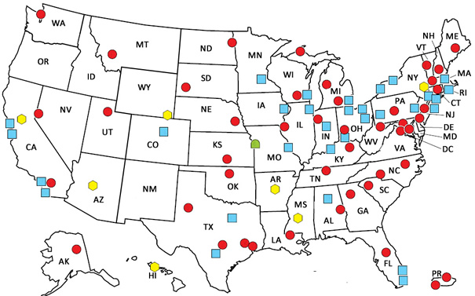
Patent and Trademark
Resource Centers (PTRCs)
Provides access to patent search resources –
  PubEAST & PubWEST
Provides information on application process and fee schedule
Offers assistance on how to do historical research patents and trademarks
Shows you a directory of local patent attorneys who are licensed to practice before the USPTO
Offers classes on intellectual property (varies by location)
Help you find assignee information and much more
http://www.uspto.gov/learning-and-resources/support-centers/patent-and-trademark-resource-centers-ptrcs
Notes:
Nationwide network of public, state, and academic libraries that:
Provides access to patent search resources
PubEAST & PubWEST, examiner-based search systems
Directs you to information on the application process and fee schedule
Demonstrates how to use search tools for a patent or trademark search
Offers assistance on how to do historical research patents and trademarks
Shows you a directory of local patent attorneys who are licensed to practice before the USPTO
Offers classes on intellectual property (varies by location)
Shows you how to track current research by company or nonprofit
Help you find assignee information and much more
http://www.uspto.gov/learning-and-resources/support-centers/patent-and-trademark-resource-centers-ptrcs

Slide 40

Regional Offices
Notes:
The USPTO now has four regional offices throughout the United States in Dallas, Denver, Detroit, and San Jose, California. These offices are staffed with patent examiners, PTAB judges, and administrative. They provide local applicants with full customer support and serve as beacons of innovation for their regional communities. In addition, they provide USPTO customers with a direct link to USPTO headquarters in Alexandria, Virginia. Every regional office is equipped with secure video conferencing technology so that applicants can meet virtually with patent examiners as needed by patent prosecution.
Additionally, each regional office sponsors multiple outreach events each year to connect with local inventors and provide valuable information and resources regarding the patent application process.

Slide 41

Thank You!
Office of Innovation Development
innovationdevelopment@uspto.gov

