Slide 1
PLEASE SIT TOWARD THE FRONT AND CENTER

Slide 2
Safety & Liability
Risk Assessment & Management
ME 4182
Capstone Design
Dr. Ken Cunefare
(a work in progress)
Last revised 9/21/17

Slide 3
Relevance to Capstone
What are the risks and consequences?
What are the failure modes for your design?
What are your risk mitigation tactics?
What Codes & Standards apply?
Document your findings concerning, and the process for addressing, these issues

Slide 4
Coverage/Contents
Managing Risk and Liability
  Hazards and Risk Assessment
  Failure Modes and Effects Analysis FMEA
Product Liability Concepts
Backup materials
  Citations and links (in progress…)
  Liability
  FMEA

Slide 5
20 Steps to Reduce Risk and Liability 1
Include safety as a primary specification in identifying needs during all phases of the product's existence
Design to a recognized standard (failure to do so may be “negligence per se”)
  UL, ANSI, ISO, ASTM (GT has ASTM stds)
  Industry/Professional Society
    ASHRAE, ASME (e.g., BPVC)
    Product/industry/manufacturer specific (Espresso!)
  Within these resources, look for
    Required analysis methods
    Required Factors of Safety
    Required testing methods
    Etc….

Slide 6
20 Steps to Reduce Risk and Liability 2
Include safety as a primary specification in identifying needs during all phases of the product's existence
Design to a recognized standard (failure to do so may be “negligence per se”)
Select materials and components that are known to have sufficient quality and a small enough standard deviation from the norm to consistently do the job expected
Apply accepted analysis techniques to determine if all electrical, mechanical, and thermal stress levels are well within published limits (what does factor of safety mean?)

Slide 7
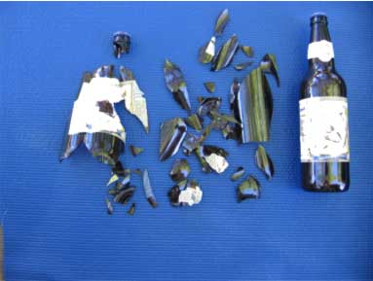
20 Steps to Reduce Risk and Liability 3
Test the device using accelerated aging tests, using a recognized test
Conduct a design review that includes persons knowledgeable about ALL aspects of a product.
Perform a failure and hazards analysis of the product for each stage of product life

Slide 8
20 Steps to Reduce Risk and Liability 4
Test the device using accelerated aging tests, using a recognized test
Conduct a design review that includes persons knowledgeable about ALL aspects of a product.
Perform a failure and hazards analysis of the product for each stage of product life
Perform a worst-case analysis of the product
Submit product to independent testing laboratory (e.g. UL)
Make sufficient information (notes on drawings, component specifications, etc.) available to the factory to identify and mitigate/eliminate hazards

Slide 9
20 Steps to Reduce Risk and Liability 5
Make a permanent record of the history of the product development.
Wherever there is a question regarding safety of a product, document the risk/utility considerations made during the design phase.
Use warning labels on the product when this is appropriate
Supply unambiguous instructions for properly installing or using the product
Determine any service or maintenance necessary to keep the product safe and operating

Slide 10
20 Steps to Reduce Risk and Liability 6
Where feasible, have all products inspected after manufacture
Inform the quality control/manufacturing of manufacturing errors that may result in a dangerous product
Test the effects of mass manufacture on the product
Work with the advertising/marketing to guard against overstatements of product performance
Encourage sales and service personnel and dealers to report any complaints that have to do with injury or economic loss (but should act on the data!) (McDonald’s coffee case burn)
Notes:
The McDonald's coffee case began when a 79-year-old woman went with her son to a McDonald's drive-thru and ordered a cup of hot coffee. The woman, a passenger in the vehicle, put the coffee between her legs and was attempting to remove the lid when the spill occurred. How hot was the coffee? The evidence at trial indicated that it was 180-190 degrees Fahrenheit when served and that it was between 165 and 170 degrees Fahrenheit when it was spilled. The evidence also showed that the coffee you make at home is usually about 135-140 degrees Fahrenheit. In a matter of six to seven seconds the spilled coffee caused third degree burns to the woman's inner thighs and buttocks. She claimed to have approximately $10,000.00 in medical costs, including the costs associated with the debridement and skin grafting necessitated by the injury. She also claimed to have permanent scarring as a result of the injury.

Slide 11
What are the risks and consequences?
What are the failure modes for your design?
What are your risk mitigation tactics?
What Codes and Standards Apply?
Document your findings concerning, and the process for addressing, these issues
Relevance to Capstone

Slide 12
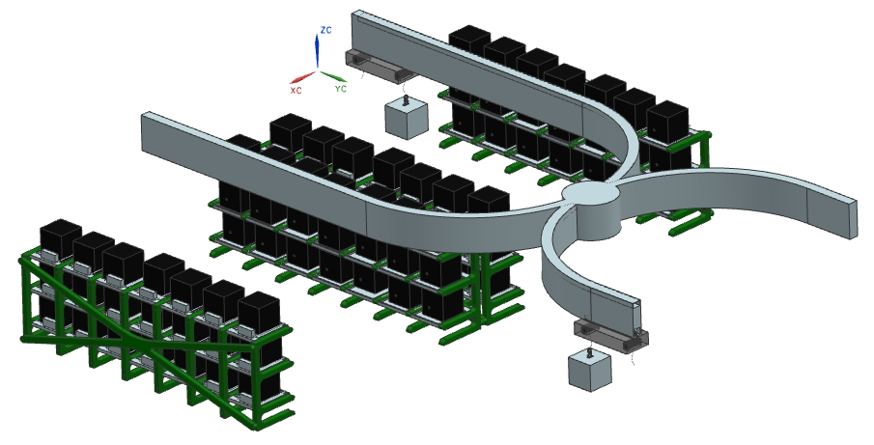
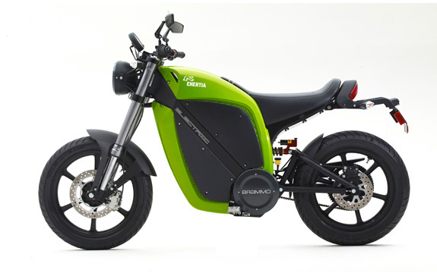
Battery removal, storage, and recharge system
What are the risks?
What are the consequences?
What are the applicable codes and standards? (California!)

Slide 13
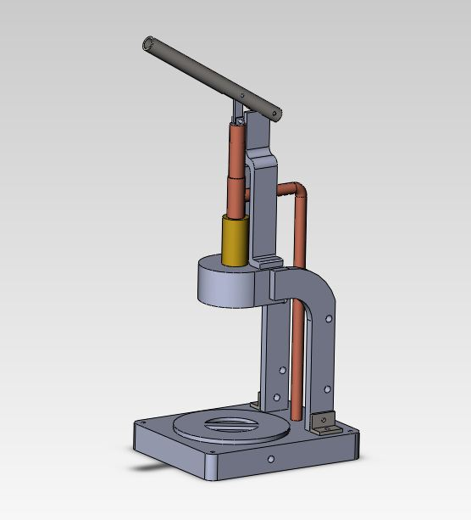
Stovetop Espresso Maker
What are the risks?
What are the consequences?
What are the available codes and standards?
  Certified Espresso

Slide 14
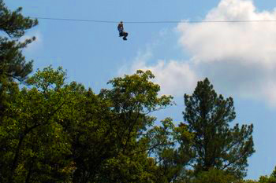
Risk Assessment
When do we accept risk?
  When it’s insignificantly low.
  When we are sure it is worth it.
  When we do not know it is there.
  When it hasn’t harmed or killed us yet
    Normalization of deviation – when the abnormal becomes accepted as routine
      Any cases spring to mind?
      Space shuttles Challenger & Columbia

Slide 15
Hazards and Risk Assessment
A formalized, structured approach to identify, assess, and mitigate risk
Failure modes and effects analysis FMEA
A formalized, structured approach to identify, assess, and mitigate failure modes (that lead to risk!)

Slide 16
Hazards and Risk Assessment
A formalized, structured approach to identify, assess, and mitigate risk

Slide 17
DEPARTMENT OF DEFENSE
STANDARD PRACTICE FOR SYSTEM SAFETY
MIL-STD-882D Matrix
CATEGORY
(1)
CATASTROPHIC
(2)
CRITICAL
(3)
MARGINAL
(4)
NEGLIGIBLE
FREQUENCY
(A) FREQUENT
( X > 10⁻¹ )
(B) PROBABLE
( 10⁻¹ > X > 10⁻³ )
(C) OCCASIONAL
( 10⁻² > X 10⁻³ )
(D) REMOTE
( 10⁻³ > X > 10⁻⁶ )
(E) IMPROBABLE
( 10⁻⁶ > X )
UNACCEPTABLE (must mitigate)
ACCEPTABLE WITH REVIEW (may mitigate)
UNDESIRABLE (should mitigate)
ACCEPTABLE WITHOUT REVIEW

Slide 18
Need to know/define/determine…
Risk Level
  (1) High – Imperative to reduce risk level.
  (2) Medium – Requires a mitigation plan.
  (3) Low – No special risk mitigation activities are required.
Severity of Consequences
  (1) Catastrophic – Death or system loss.
  (2) Critical - Severe injury or major system damage.
  (3) Marginal - Injury requiring medical attention or system damage.
  (4) Negligible - Possible minor injury or minor system damage.

Slide 19
Need to know/define/determine…
Frequency of Exposure
  (A) Frequent - Expected to occur frequently.
  (B) Probable - Will occur several times in the life of an item.
  (C) Occasional - Likely to occur sometime in the life of an item.
  (D) Remote - Unlikely, but possible to occur in the life of an item.
  (E) Improbable - So unlikely, it can be assumed occurrence may not be experienced.

Slide 20
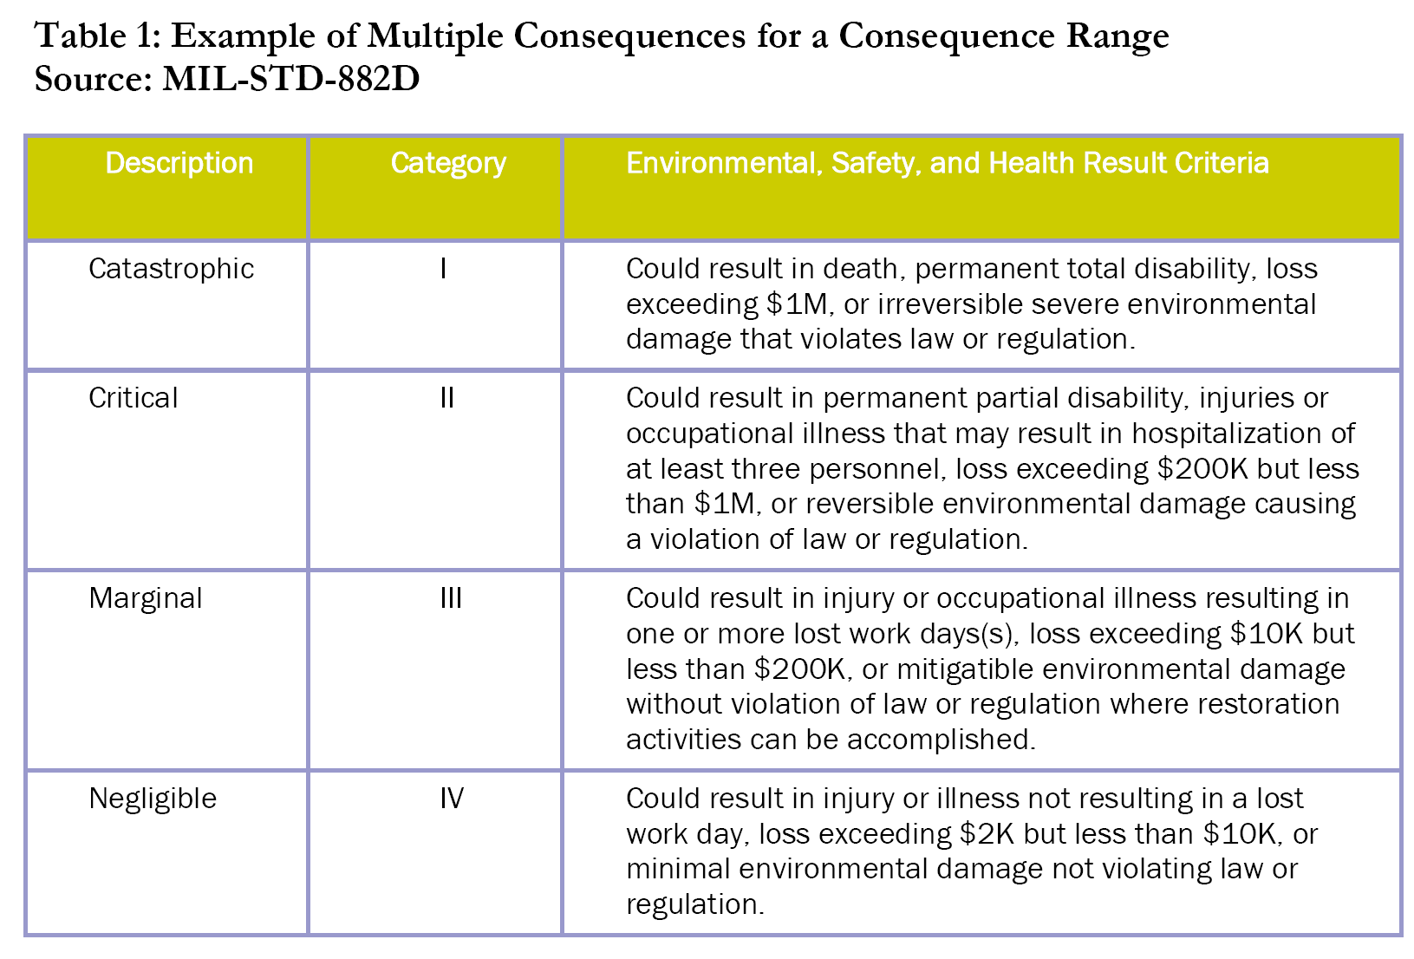
Example “Consequences”

Slide 21
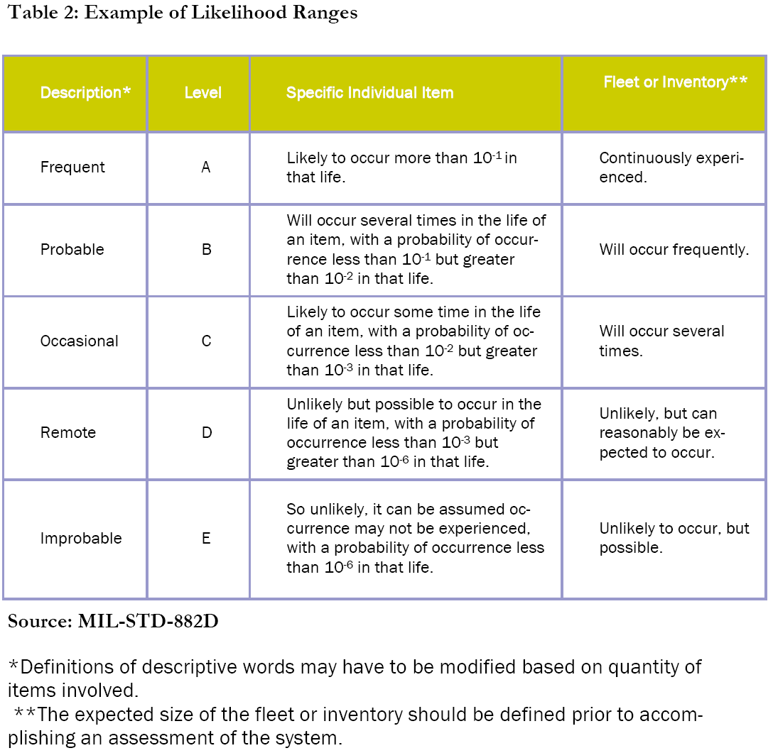

Slide 22
DEPARTMENT OF DEFENSE
STANDARD PRACTICE FOR SYSTEM SAFETY
MIL-STD-882D Matrix
CATEGORY
(1)
CATASTROPHIC
(2)
CRITICAL
(3)
MARGINAL
(4)
NEGLIGIBLE
FREQUENCY
(A) FREQUENT
( X > 10⁻¹ )
(B) PROBABLE
( 10⁻¹ > X > 10⁻³ )
(C) OCCASIONAL
( 10⁻² > X 10⁻³ )
(D) REMOTE
( 10⁻³ > X > 10⁻⁶ )
(E) IMPROBABLE
( 10⁻⁶ > X )
UNACCEPTABLE (must mitigate)
ACCEPTABLE WITH REVIEW (may mitigate)
UNDESIRABLE (should mitigate)
ACCEPTABLE WITHOUT REVIEW

Slide 23
Okay, you’ve defined your risk tolerance
Now what?
FMEA (or other assessment tool)

Slide 24
What is FMEA?
Failure Mode and Effects Analysis
Methodology of FMEA:
  Identify the potential failure of a system and its effects (Risk Assessment RA)
  Assess the failures to determine actions that would eliminate the chance of occurrence
  Document the potential failures
Mitigate the potential failures (connect back to RA)
Notes:
FMEA is a methodology used to:
1. Identify the possible failures that a component can have on a system.
2. Assess how these failures could affect the system.
3. Document the possible failures and the potential effects they could have on the system.

Slide 25
FMEA
The aim of FMEA is to anticipate:
  what might fail
  what effect this failure would have
  what might cause the failure
… and take action to correct it!
(see backup materials for process)

Slide 26
Battery removal, storage, and recharge system

Slide 27
Summary - FMEA Flowchart
Identify a failure mode
Determine the possible effects of the failure
Assess the potential severity of the effect
Identify the cause of failure (take action!)
Estimate the probability of occurrence
Assess the likelihood of detecting the failure
Assign an RPN (= S x O x D) or other RA
Take action to reduce highest risk; REPEAT

Slide 28
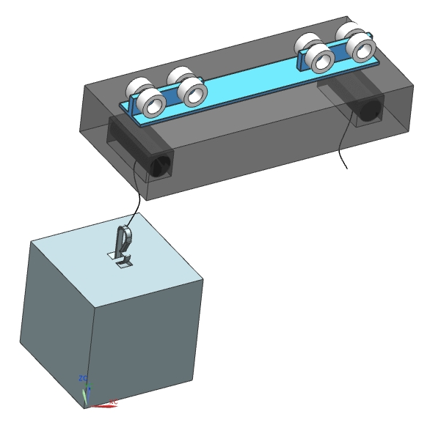
Battery Support/Trolley System

Slide 29
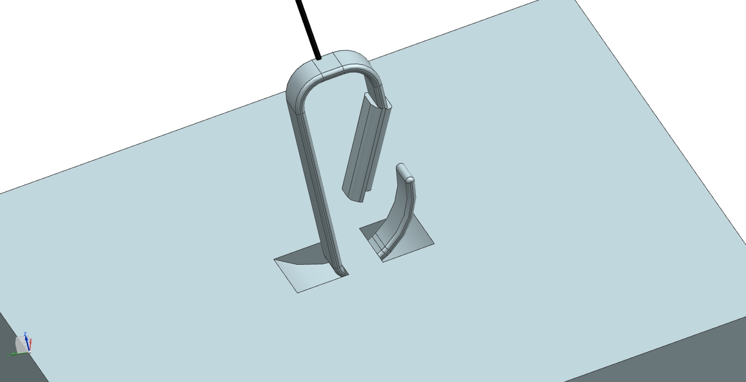
Battery Attachment
Beware single-point failures!

Slide 30
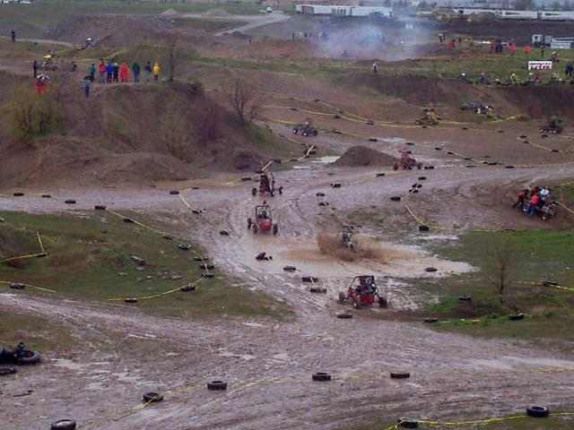
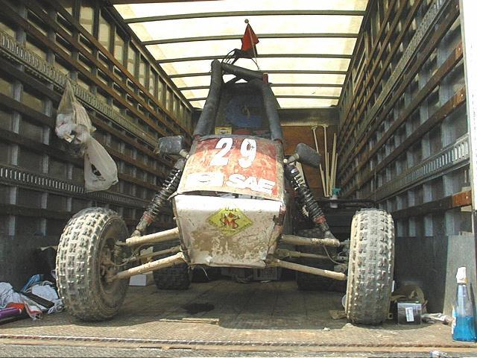
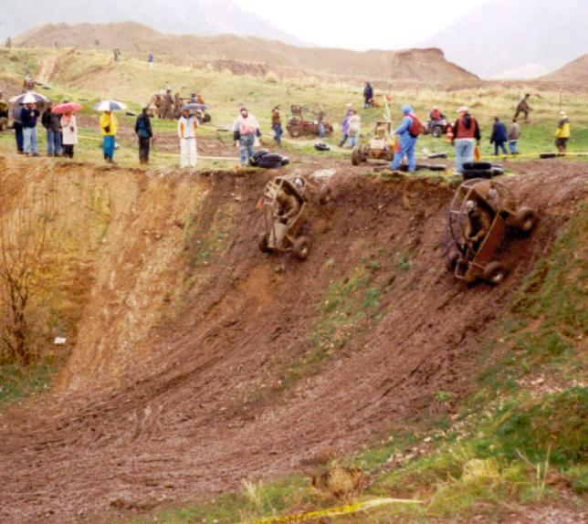
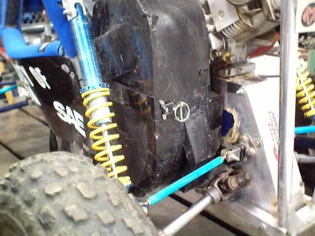
Example Risk Assessment Matrix

Slide 31


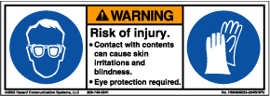
Example Mini-Baja HAR
Identify & Assess
Mitigate

Slide 32
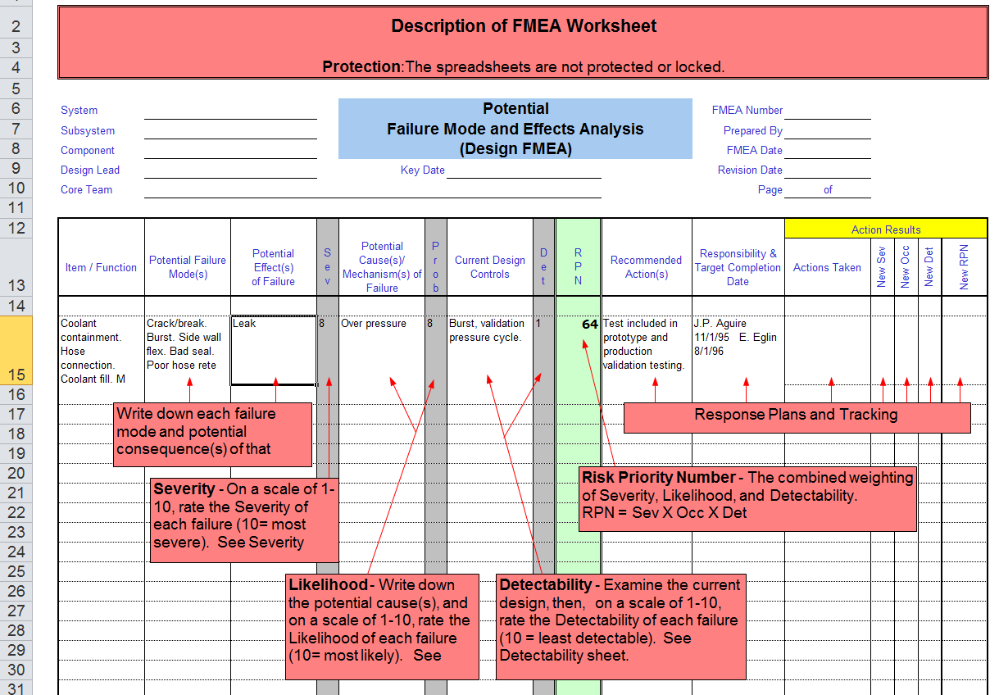
FMEA Template

Slide 33
What are the risks and consequences?
What are the failure modes for your design?
What are your mitigation tactics?
Document your findings concerning, and the process for addressing, these issues
Relevance to Capstone

Slide 34
Product Liability Concepts
Definition:
  Corporate liability for injuries or damages suffered by the user from products
Applies to manufacturers, sellers and distributors of goods
Liability: An obligation to rectify or recompense for any injury or damage for which the liable person has been held responsible or for failure of a product to meet a warranty.

Slide 35
Legal Theories
Three theories in Product Liability cases:
  Strict Liability
  Breach of Warranty
  Negligence

Slide 36
Definitions & Concepts 1
Strict liability in tort: The legal theory that a manufacturer of a product is liable for injuries due to product defects, without the necessity of showing negligence of the manufacturer.
  Defect in design
  Defect in manufacture

Slide 37
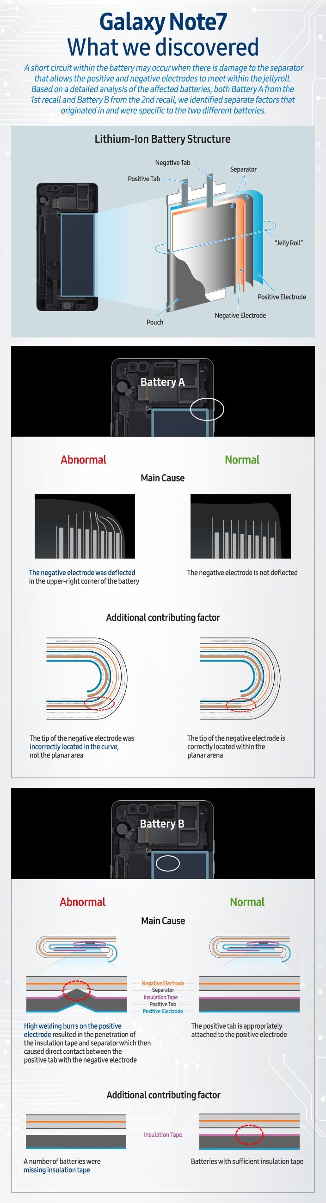
Definitions & Concepts 2
  Defect in design
  Defect in manufacture
Notes:
http://www.theverge.com/2017/1/22/14353686/samsung-galaxy-note-7-recall-reason-report

Slide 38
Definitions & Concepts 3
Breach of warranty: Failure of the product to meet its warranty, be it either express or implied
Express warranty: A statement by a manufacturer or seller, either in writing or orally, that his product is suitable for a specific use and will perform in a specific way.
Implied warranty: An automatic warranty, implied by law, that a manufacturer's or dealer's product is suitable for either ordinary or specific purposes and is reasonably safe for use (“merchantability and fitness”; McDonald’s coffee-burn case)

Slide 39
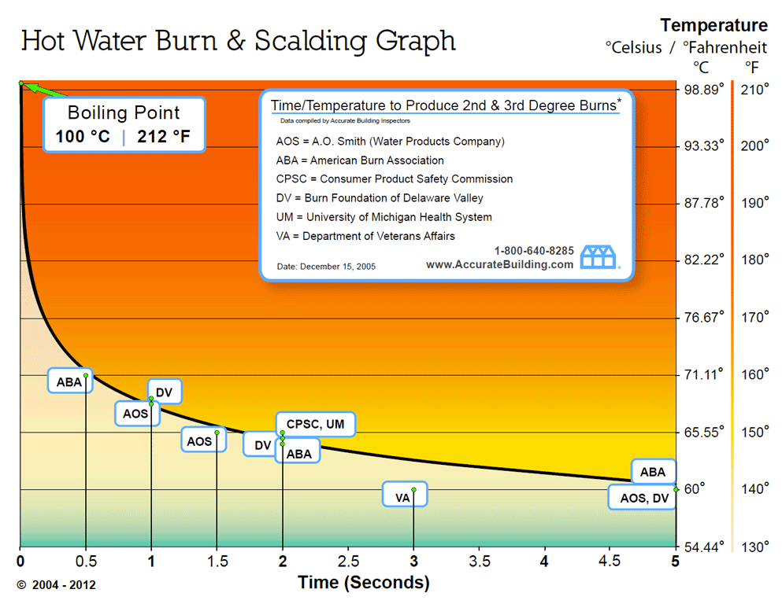
20 steps
Notes:
http://www.accuratebuilding.com/services/legal/charts/hot_water_burn_scalding_graph.html

Slide 40
Definitions & Concepts 4
Negligence: Failure to exercise a reasonable amount of care or to carry out a legal duty which results in injury or property damage to another
Contributory negligence: Negligence of the plaintiff that contributes to his injury and at common law ordinarily bars him from recovery from the defendant although the defendant may have been more negligent than the plaintiff
Negligence per se: Breach of a regulation or a standard which was designed to prevent the type of harm suffered by the plaintiff

Slide 41
Definitions & Concepts 5
Duty of care: The legal duty of every person to exercise due care for the safety of others and to avoid injury to others whenever possible.
Great care: The high degree of care that a very prudent and cautious person would undertake for the safety of others.
Reasonable care: The degree of care exercised by a prudent person in observance of his legal duties toward others.

Slide 42
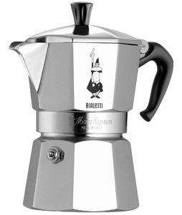
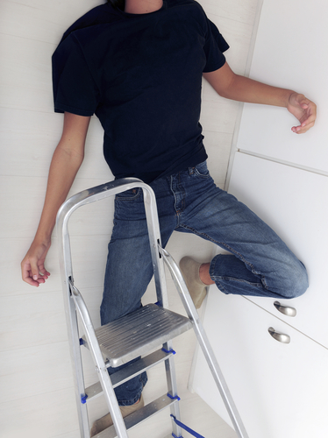
Definitions & Concepts 6
Foreseeability: The legal theory that a person may be held liable for actions that result in injury or damage only where he was able to foresee dangers and risks that could reasonably be anticipated.
http://carpelibrisreviews.com/bialetti-moka-express-stovetop-coffee-maker-giveaway/
http://www.broussard-david.com/lawyer-attorney-2090529.html

Slide 43
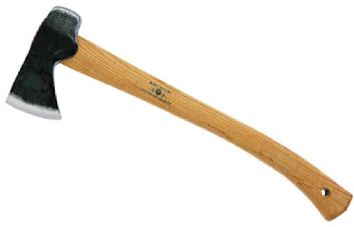
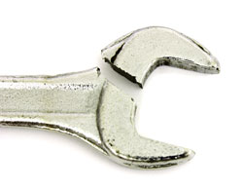

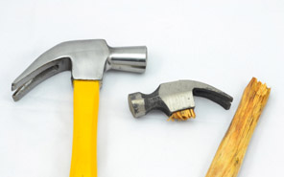

Definitions & Concepts 7
Obvious peril: The legal theory that a manufacturer is not required to warn prospective users of products whose use involves an obvious peril, especially those that are well known to the general public and that generally cannot be designed out of the product.
http://www.norriscantulaw.com/defective-products/
http://www.michaels-smolak.com/lawyer-attorney-1501239.html
http://www.conybearelaw.com/practice-areas/product-liability/
http://www.arizonapilawyer.com/personal-injury/defective_product.html

Slide 44
Definitions & Concepts 8
Assumption of risk: The legal theory that a person who is aware of a danger and its extent and knowingly exposes himself to it assumes all risks and cannot recover damages, even though he is injured through no fault of his own.

Slide 45
Assumed Risk
A person who is aware of a danger and its extent and knowingly exposes himself to it assumes all risks and cannot recover damages, even though he is injured through no fault of his own.
But may recover under other theory, e.g., negligence or breach of warranty
www.historicbanningmills.com

Slide 46
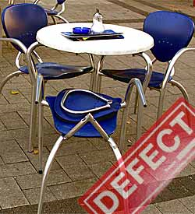
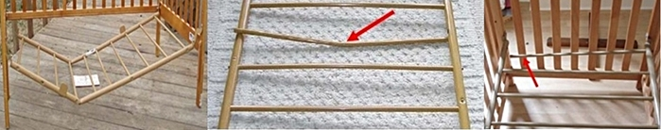
Liability suits to come?
http://www.recalls.gov/recent.html
http://www.cpsc.gov/

Slide 47
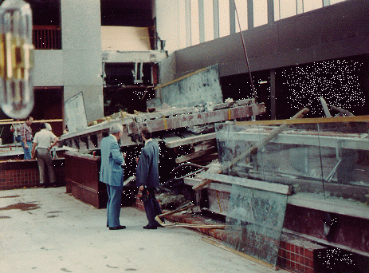
HYATT REGENCY WALKWAY COLLAPSE http://www.materials.drexel.edu/programs/Sensors/Links/
INTRODUCTION
On July 17, 1981, two suspended walkways collapsed in the Hyatt Regency Hotel in Kansas City, Missouri during a dance festival
114 dead and in excess of 200 injured.
Millions of dollars in costs related to lawsuits, etc., resulted from the collapse, and hundreds of lives were adversely affected.
47

Slide 48
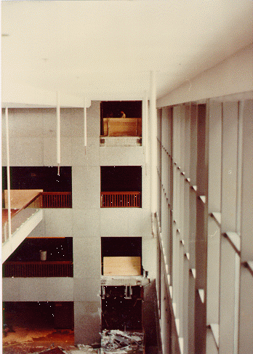
HYATT REGENCY WALKWAY COLLAPSE
48

Slide 49
HYATT REGENCY WALKWAY COLLAPSE
Original
Walkways suspended long rods.
Rod through the top walkway down to bottom walkway.
On each rod, under each walkway, nut used to carry the load of walkway.
Issue
Running nuts 30 feet up the rods, the entire length of the rods had to be threaded.
Threading 30 feet of rod difficult and costly.
The fabricator decided to modify the original design to make it easier and less costly to construct.
49

Slide 50
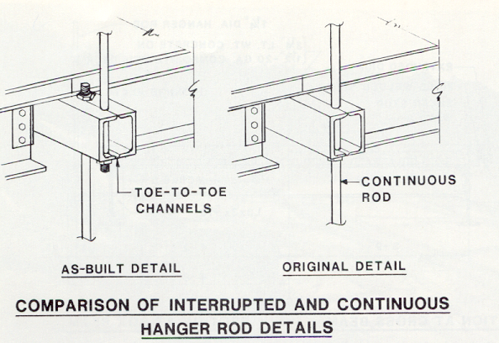
50

Slide 51
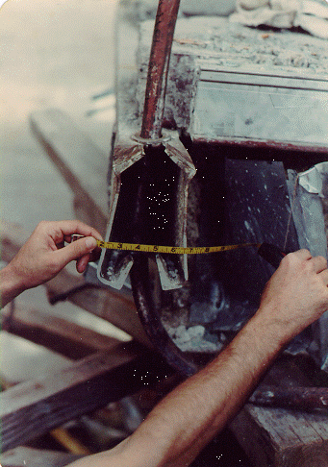
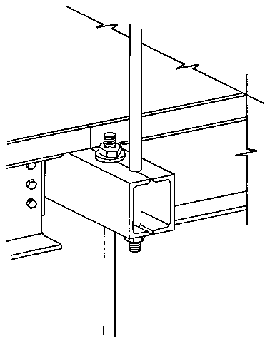
Walkway-design: Nut 1 supports only the walkway above it. The weight of the second walkway is supported through the rod.
Walkway-built: Nut 1 not only holds the weight of the walkway above it, but also the hanging weight of the second walkway and the rods used to support it.
51

Slide 52
Deformed 4th Floor Beam
52

Slide 53
HYATT REGENCY WALKWAY COLLAPSE
Negligence Per se
Failure of either design to meet Kansas City Building Codes
KCBC dictated minimum value for mean ultimate load capacity for beams should be 151 kN.
The mean ultimate capacity of the single-rod connection approximately 91 kN, depending on the weld area
Capacity actually available using the original connection 60% of that expected of a connection designed in accordance with AISC Specifications
Modified and as-built design held 30% of the minimum weight by KCBC
By mere calculations, the first design was obviously the more effective one even though it was faulty to begin with
How many legal theories of liability apply?
53

Slide 54
What are the failure modes for your design?
What are the risks and consequences?
What are your risk mitigation tactics?
What Codes & Standards apply?
Document your findings concerning, and the process for addressing, these issues
Relevance to Capstone

Slide 55


Slide 56
Coverage/Contents
Product Liability
Hazards and Risk Assessment
Failure Modes and Effects Analysis FMEA
Backup materials
  Citations and links (in progress…)
  Liability
  FMEA

Slide 57
Citations and links
References
  What every engineer should know about product liability, Thorpe and Middendorf, Marcel Dekker, Inc., New York, NY, 1979.
  Fundamentals of product liability law for engineers, Enghagen, Industrial Pres, Inc., New York, NY, 1992.
  Products Liability, Smith’s Review, Finz, Emanual Law Outlines, Inc., Larchmont NY,1993.
  Products liability: Design and Manufacturing Defects, Bass, Shepard’s/McGraw Hill, Colorado Springs, CO, 1986. (this one is quite a weighty tome)
  Designing an effective Risk Matrix, An ioMosaic Corporation Whitepaper, Salem, NH, 2009.
Source materials
  Materials on ethics and liability, including the KC Hilton
  Ethics & FMEA

Slide 58
Legal Theories
Definitions and Concepts (support)
“Causes of action”
Legal theory under which plaintiff believes damages should be awarded
Basis of court’s jurisdiction (civil law; state & Fed)
Required conditions for an action:
  Tort: A wrongful act or failure to exercise due care, from which a civil legal action may result.
  Proximate cause: The act that is the natural and reasonably foreseeable cause of the harm or event that occurs and injures the plaintiff.

Slide 59
Additional materials on legal aspects

Slide 60
Recoverable Damages
Personal injuries
  Past, present and future
Fair and adequate compensation
Medical expenses
Lost earnings
Pain and suffering
Impaired future earnings capacity
Property damage
Punitive damages
  (most states)

Slide 61
Punitive Damages
Awarded to Plaintiff over and above full compensation for injuries
Intended to “punish” defendant and “deter” others from following the defendants example
Example:
  Coffee spill cases
  Airline crashes

Slide 62
Strict Liability
Liability without fault
Proximate Causation

Slide 63
Negligence
Failure to exercise reasonable care under circumstances
Contributory Negligence
Duty, breach, damages

Slide 64
“Negligence Per Se”
Violation of a regulation which was designed to prevent the type of harm suffered by the plaintiff
E.g., design not conforming to standards, not conforming to regulation

Slide 65
Breach of Warranty
Manufacture liable if product was not “reasonably safe” and did not conform to an express or implied warranty
Strict liability if warranty breached
Express vs. Implied Warranties
  Express = “basis of the bargain”
  Implied = given by someone “in the business of selling”

Slide 66
Negligence
The law of negligence imposes a duty to think before you act.
The ordinary care standard imposes a social standard which is judged by members of the community who may or may not agree with your evaluation of your own conduct.
Therefore, it is important to look at your acts and omissions from the stand point of others in the community who will be judging your conduct.
If you have negligence concerns, ask:
1. What would members of the community require me to do under these circumstances;
2. What would members of the community forbid me to do under these circumstances;
3. What would members of my profession/vocation/calling require of me under these circumstances;
4. What would members of my profession/vocation/calling counsel me to avoid under these circumstances;
5. What are the risks of my conduct, considering the probability of harm and the degree of injury or damage that would result if an accident occurred; and
6. Would ordinary people in the community believe that I am taking reasonable risks?
66
Notes:
66

Slide 67
Proving Negligence
67
Negligence is 'conduct which falls below the standard established by law for the protection of others against unreasonable risk of harm' [4].
In order to establish liability for damage, the courts analyze the following four elements:
  duty
  breach
  proximate cause
  damages.
Notes:
67

Slide 68
Proving Negligence
68
Negligence: the injured party (plaintiff) must prove:
a) that the party alleged to be negligent had a duty to the injured party-specifically to the one injured or to the general public,
b) that the defendant's action (or failure to act) was negligent-not what a reasonably prudent person would have done because it did not fulfill the “standard of care” typical of how any similar engineer would judge and act in similar situations
c) that the damages were caused ("proximately caused") by the negligence.
d) That the damages were "reasonably foreseeable" at the time of the alleged negligence.
Notes:
68

Slide 69
Standard of Care
69
In legal cases, a judge or jury, has to determine what the standard of care is and whether an engineer has failed to achieve that level of performance.
They do so by hearing expert testimony.
People who are qualified as experts express opinions as to the standard of care and as to the defendant engineer's performance relative to that standard.
The testimony from all sides is weighted and then a decision is made what the standard of care was and whether the defendant met it
Notes:
69

Slide 70
Standard of Care
Jury instructions have been standardized. A Bench Approved Jury Instruction (BAJI, 1986) reads:
"In performing professional services for a client, a (structural engineer) has the duty to have that degree of learning and skill ordinarily possessed by reputable (structural engineers), practicing in the same or similar locality and under similar circumstances.
It is (the structural engineer's) further duty to use the care and skill ordinarily used in like cases by reputable members of the (structural engineering) profession practicing in the same or similar locality under similar circumstances, and to use reasonable diligence and (the structural engineer's) best judgment in the exercise of professional skill and in the application of learning, in an effort to accomplish the purpose for which (the structural engineer) was employed.
A failure to fulfill any such duty is negligence"
70
Notes:
70

Slide 71
Standard of Care
Three key items in this instruction bear repeating:
...have learning and skill ordinarily possessed by reputable engineers practicing in the same or similar locality and under similar circumstances.
...use care and skill ordinarily possessed by reputable engineers practicing in the same or similar locality and under similar circumstances.
...use reasonable diligence and best judgment to accomplish the purpose for which the engineer was employed.
If any one of these conditions is not met, the engineer has failed to meet the standard of care, and is professionally negligent.
71
Notes:
71

Slide 72
Comparative Negligence
Negligence involving joint tortfeasors
Joint Tortfeasors (wrongdoers): two or more persons whose negligence in a single accident or event causes damages to another person.
In many cases the joint tortfeasors are jointly and severally liable for the damages, meaning that any of them can be responsible to pay the entire amount, no matter how unequal the negligence of each party was.
Example: Harry Hotrod is doing 90 miles an hour along a two-lane road in the early evening,
Adele Aimster has stopped her car to study a map with her car sticking out into the lane by six inches.
Hotrod swings out a couple of feet to miss Aimster's vehicle, never touches the brake, and hits Victor Victim, driving from the other direction, killing him.
While Hotrod is grossly negligent for the high speed and failure to slow down, Aimster is also negligent for her car's slight intrusion into the lane. As a joint tortfeasor she may have to pay all the damages, particularly if Hotrod has no money or insurance.
However, comparative negligence rules by statute or case law in most jurisdictions will apportion the liability by percentages of negligence among the tortfeasors and the injured parties.
72
Notes:
72

Slide 73
Res Ipsa Loquitur
(The Thing Speaks for Itself)
(rayz ip-sah loh-quit-her) n. Latin for "the thing speaks for itself,"
A doctrine of law that one is presumed to be negligent if he/she had exclusive control of whatever caused the injury even though there is no specific evidence of an act of negligence, and without negligence the accident would not have happened.
Examples: a) a load of bricks on the roof of a building being constructed by High-rise Construction Co. falls and injures Paul Pedestrian below
High-rise is liable for Pedestrian's injury even though no one saw the load fall.
b) While under anesthetic, Isabel Patient's nerve in her arm is damaged although it was not part of the surgical procedure, and she is unaware of which of a dozen medical people in the room caused the damage.
Under res ipsa loquitur all those connected with the operation are liable for negligence.
Lawyers often shorten the doctrine to "res ips," and find it a handy shorthand for a complex doctrine.
73
Notes:
73

Slide 74
Negligence Per Se
Negligence due to the violation of a public duty, such as high speed driving.
In Black’s Law Dictionary negligence ’per se’ is defined as: “Conduct, whether of action or omission, which may be declared and treated as negligence without any argument or proof as to the particular surrounding circumstances, either because it is in violation of a statute or valid municipal ordinance, or because it is so palpably opposed to the dictates of common prudence that it can be said without hesitation or doubt that no careful person would have been guilty of it. As a general rule, the violation of a public duty, enjoined by law for the protection of person or property, so constitutes."
74
Notes:
74

Slide 75
Details on FMEA

Slide 76
What is FMEA?
FMEA is an acronym that stands for Failure Mode and Effects Analysis
Methodology of FMEA:
  Identify the potential failure of a system and its effects
  Assess the failures to determine actions that would eliminate the chance of occurrence
  Document the potential failures
Notes:
FMEA is a methodology used to:
1. Identify the possible failures that a component can have on a system.
2. Assess how these failures could affect the system.
3. Document the possible failures and the potential effects they could have on the system.

Slide 77
FMEA
The aim of FMEA is to anticipate:
  what might fail
  what effect this failure would have
  what might cause the failure
… and take action to correct it!

Slide 78
FMEA
The significance of the failure is assessed against:
  The probability of failure
  An assessment of the severity of the effect of that failure
  The probability of existing quality systems spotting the failure before it occurs (detection)

Slide 79
Where Does FMEA Occur?
Planning
Concept
Development
System-Level
Design
Detail
Design
Testing and
Refinement
Production
Ramp-Up
Concept FMEA
(CFMEA)
Design FMEA
(DFMEA)
Process FMEA
(PFMEA)

Slide 80
Design Project FMEA
Design FMEA’s should cover:
  all new components
  carried over components in a new environment
  any modified components
Mandatory on all control and load carrying parts

Slide 81
FMEA Process
For each component
Identify a failure mode
Determine the possible effects or consequences of the failure
Assess the potential severity of the effect
Identify the cause of failure (take action!)
Estimate the probability of occurrence
Assess the likelihood of detecting the failure

Slide 82
1. Failure Mode
Failure mode - the manner in which a component or system failure occurs (doesn’t meet design intent)
Potential failure modes
  Complete failure
  Partial failure
  Intermittent failure
  Failure over time
  Over-performance failure

Slide 83
Failure Mode - Identification
List potential failure modes for the particular part or function
  assume the failure could occur, however unlikely
For example, sketch free-body diagrams (if applicable), showing applied/reaction loads. Indicate location of failure under this condition.
List conceivable potential causes of failure for each failure mode

Slide 84
2. Failure Mode – Effects
For each failure mode, identify the potential downstream consequences of each failure mode (the Effects)
Team brainstorms to identify failure modes and effects
FM-1 Effect 1-1
Effect 1-2
Effect 1-3
FM-2 Effect 2-1
Effect 2-2

Slide 85
3. Failure – Severity
To analyze risk, first quantify the severity of the Effects
  Assume that all Effects will result if the Failure Mode occurs
  Most serious Effect takes precedence when evaluating risk potential
  Design and process changes can reduce severity ratings

Slide 86
DFMEA Severity Table
Severity of Failure | Rank
Hazardous – No warning: Unsafe operation, without warning | 10
Very high: Product inoperable; loss of primary function | 8, 9
High: Product operable, but at a reduced level | 6, 7
Low: Product operable; comfort or convenience items at reduced level | 4, 5
Minor: Fit/finish, squeak/rattle don’t conform; average customer notices | 2, 3
No effect | 1

Slide 87
4. Failure Mode – Causes
After Effects and Severity addressed, identify the Causes of the Failure Modes
Causes of failure that result in a Failure Mode are design deficiencies
Causes are rated in terms of Probability of Occurrence
  Likelihood that a given Cause will occur AND result in the Failure Mode

Slide 88
5. Failure Mode - Occurrence
Estimate the probability of occurrence on a scale of 1 -10
  consider any fail-safe controls intended to prevent cause of failure
Consider the following two probabilities:
  probability the potential cause of failure will occur
  probability that once the cause of failure occurs, it will result in the indicated failure mode

Slide 89
Failure Occurrence - Ranking
Occurrence Criteria | Rank
Very High – almost certain failure, in a major way | 10
High – similar designs have failed in the past | 7, 8, 9
Moderate – similar designs have occasional moderate failure rates | 4, 5, 6
Low – similar designs have low failure rates | 2,3
Remote - unreasonable to expect failure | 1

Slide 90
Example DFMEA Occurrence Table
Probability of Failure | Failure Rates | Rank
Very High: Failure almost inevitable | > 1 in 2 | 10
 | 1 in 3 | 9
High: Repeated failures | 1 in 8 | 8
 | 1 in 20 | 7
Moderate: Occasional failures | 1 in 80 | 6
 | 1 in 400 | 5
 | 1 in 2000 | 4
Low: Relatively few failures | 1 in 15,000 | 3
 | 1 in 150,000 | 2
Remote: Failure unlikely | < 1 in 1,500,000 | 1

Slide 91
Current Controls
Design controls grouped according to purpose
  Type 1 Controls: prevent Cause or Failure Mode from occurring, or reduce rate of occurrence
    Ex: Shear pin designed to fail to keep system from failing
  Type 2 Controls: detect Cause of Failure Mode and lead to corrective action
    Ex: LED lights when batteries are low
  Type 3 Controls: detect Failure Mode before product reaches “customer”
    Ex: 100% inspection

Slide 92
6. Detection
Detection values are associated with type of Controls
Detection is a measure of Type 2 Controls to detect Causes of Failure, or ability of Type 3 Controls to detect subsequent Failure Modes
High values indicate a Lack of Detection
Value of 1 does not imply 100% detection

Slide 93
DFMEA Detection Table
Detection | Criteria: Likelihood of Detection | Rank
Absolute Uncertainty | Design Control does not detect, or there is no Design Control | 10
Very Remote | Very remote chance Control will detect | 9
Remote | Remote chance Control will detect | 8
Very Low | Very low chance Control will detect | 7
Low | Low chance Control will detect | 6
Moderate | Moderate chance Control will detect | 5
Moderately High | Mod. High chance Control will detect | 4
High | High chance Control will detect | 3
Very High | Very high chance Control will detect | 2
Almost Certain | Control almost certain to detect | 1

Slide 94
Design Project FMEA - RESULTS
Risk Priority Number (RPN)
  Note: S, O, and D are not equally weighted in terms of risk, and individual scales are not linear
RPN = S x O x D
S = Severity, O = (Probability of) Occurrence, D = Detection

Slide 95
Interpreting the RPN
No physical meaning to RPN
Used to “bucket problems”
Rank order according to RPN
Don’t spend a lot of time worrying about what a measure of “42” means
Note that two failure modes may have the same RPN for far different reasons:
  S=10, O=1, D=2: RPN = 20
  S=1, O=5, D=4: RPN = 20

Slide 96
Criticality (Another Measure)
High Severity values, coupled with high Occurrence values merit special attention
  (Detection has been omitted from the RPN)
Although neither RPN nor Criticality are perfect measures, they are widely used for risk assessment
Criticality = S x O

Slide 97
Reducing Risk
The fundamental purpose of the FMEA is to recommend and take actions that reduce risk
Design revision may result in lower Severity and Occurrence ratings
Revised ratings should be documented with originals in Design History File

Slide 98
Actions
Actions taken are the important part of FMEA
Change design to reduce:
  Severity (consider redundancy?)
  Occurrence (change in design, or processes)
  Detection (improve ability to identify the problem before it becomes critical)
Assign responsibility for action
Follow up and assess result with new RPN

Slide 99
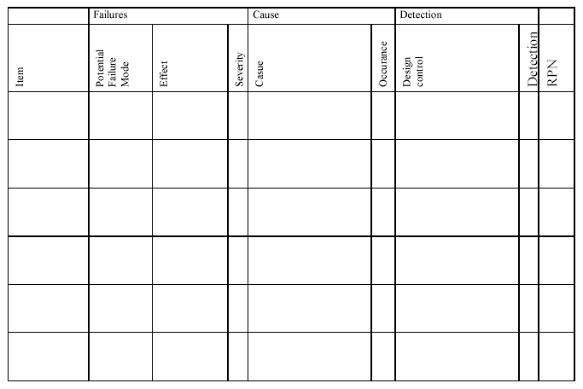
FMEA DOCUMENT

Slide 100
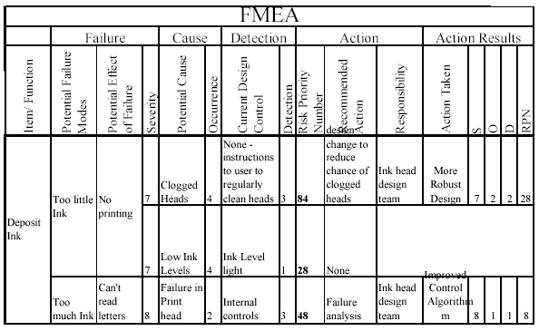
FMEA DOCUMENTATION

Slide 101
FMEA
Benefits
Systematic way to manage risk
Comprehensive
Prioritizes risk management actions
Problems
Based on qualitative assessment
Can be unwieldy
Hard to trace through levels
Not always followed up

Slide 102
Summary - FMEA Flowchart
Identify a failure mode
Determine the possible effects of the failure
Assess the potential severity of the effect
Identify the cause of failure (take action!)
Estimate the probability of occurrence
Assess the likelihood of detecting the failure
Assign an RPN (= S x O x D)
Take action to reduce highest risk; REPEAT

Slide 103
OTHER BACKUPS

Slide 104
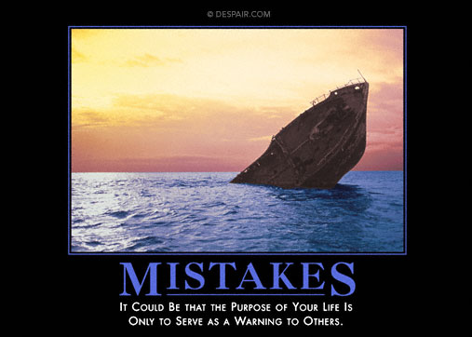
Could It Be that the Purpose of Your Capstone Project
Is Only To Serve As A Warning To Others?
www.despair.com

