Slide 1
Georgia Farm to Fly Workshop
BETO Aviation Overview
December 3, 2015
Craig Brown
Sr. Research Analyst
BCS Inc. Contractor to BETO

Slide 2
Bioenergy Technologies Office
Mission
Strategy
Performance Goal
Accelerate the commercialization of advanced biofuels and bioproducts through RD&D of new technologies supported by public-private partnerships
Develop technologies to enable the sustainable, nationwide production of biofuels compatible with today’s transportation infrastructure
Validate at least one pathway for $3/GGE* hydrocarbon biofuel with ≥50% reduction in GHG emissions relative to petroleum by 2017
*Mature modeled price at pilot scale.
BETO reduces risks and costs to commercialization through RD&D

Slide 3
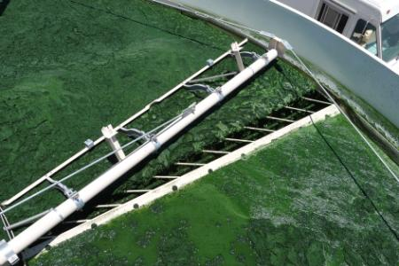
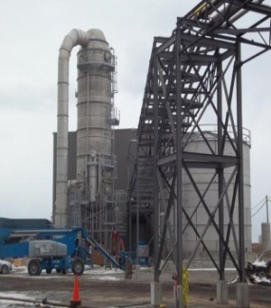
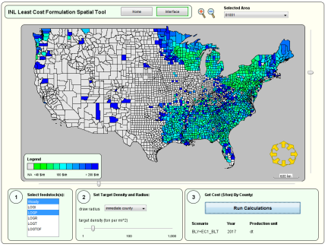
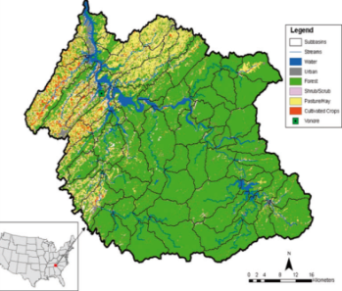
BETO’s Core Focus Areas
Program Portfolio Management
• Planning • Systems-Level Analysis • Performance Validation and Assessment
• MYPP • Peer Review • Merit Review • Quarterly Portfolio Review
• Competitive • Non-competitive • Lab Capabilities Matrix
Research, Development, Demonstration, & Market Transformation
Feedstock
Supply &
Logistics R&D
Terrestrial
Algae
Product Logistics Preprocessing
Conversion R&D
Biochemical
Thermochemical
Deconstruction
Biointermediate
Upgrading
Demonstration & Market Transformation
Integrated Biorefineries
Biofuels Distribution Infrastructure
Cross Cutting
Sustainability
Sustainability Analysis
Sustainable System Design
Strategic Analysis
Technology and Resource Assessment
Market and Impact Analysis
Model Development & Data compilation
Strategic Communications
New Communications Vehicles & Outlets
Awareness and Support of Office
Benefits of Bioenergy/
Bioproducts
Notes:
BETO’s mission is to support research, development, demonstration, and deployment of advanced bioenergy. Our Office spans the bioenergy supply chain.
Feedstock supply efforts focus on RD&D to develop cost-effective integrated logistics systems—so this includes growing, harvesting, collecting, storing, preprocessing, handling, and transporting quality feedstock to biorefineries.
Our conversion R&D program is focused on developing commercially viable technologies to convert terrestrial and algal feedstocks into liquid fuels, as well as bioproducts and biopower.
Biochemical Conversion R&D efforts focus on pathways for producing sugars and other carbohydrate intermediates followed by conversion to finished fuels.
Thermochemical Conversion R&D is focused on pathways producing bio-oil and gaseous intermediates from biomass followed by upgrading to finished fuels.
The Demonstration and Deployment (D&D) program is focused on demonstrating and validating biomass conversion technologies through successful construction and operation of cost-shared pilot, demonstration, and commercial scale integrated biorefineries.
We have crosscutting programs in Sustainability and Strategic Analysis.
Proactively addresses sustainability of advanced bioenergy to enhance its benefits, public acceptance, and long-term viability.
Conducts key analyses to guide planning and portfolio management and provides the analytical basis for R&D prioritization, target development and assessment of progress towards goals

Slide 4
Reducing Risk Along the Supply Chain
Technical, construction, operational, financial and market risk reduction
Demonstration through greater process integration and scale
Key Challenges
Biomass | Pretreatment | Conversion | Product
Reliable supply Consistent quality Affordable delivery | Biomass feeding, sizing and moisture Solids handling Construction materials | Products Yields Construction materials Catalysts Fermentation organisms | Separations Catalytic upgrading Recycle loops
DOE works to address risks and reduce costs across the supply chain
Notes:
Moved ‘key challenges all on to one line. Is there a way to be less repetitive with words by not repeating the same verbiage in every box
Changed size of graphic to better overlap challenge boxes

Slide 5
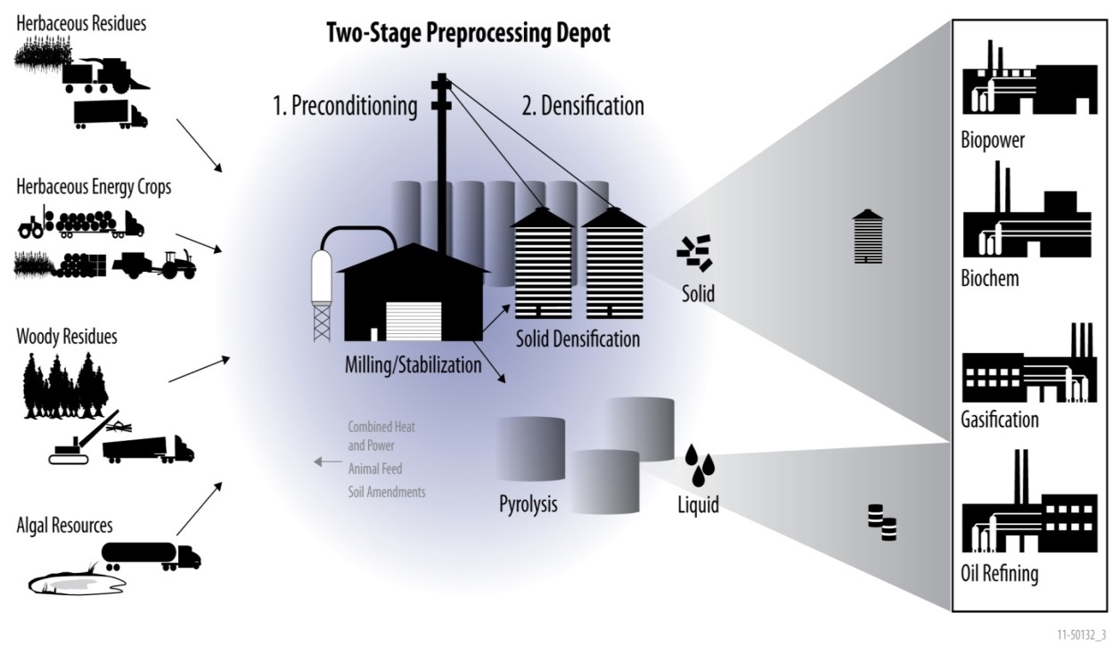
Feedstock Logistics Activities
Objective: Transform raw biomass into high-density, stable, commodity feedstocks
Priorities for next 5-10 years
Identify and validate markets in which logistics can establish a competitive position vs. the current supply and demand.
Enhance the performance of the logistics equipment to efficiently handle different types of regional biomass.
Test and validate at-scale
Enable national biomass utilization
Advanced logistics work for FY16
Actively manage feedstock variability and supply uncertainty: Downselect to working blends meeting cost, quality, & convertibility targets
Scale-up: Advanced logistics projects; PDU
Notes:
This slide explains why we are working on blending in FY16
Actively manage feedstock variability and supply uncertainty
Feedstock specifications and conversion performance drive logistics and preprocessing
Advanced preprocessing accesses low-grade and diffuse resources (i.e., use any and all available resources)
Advanced preprocessing and formulation of multiple raw biomass resources into least cost/performance-based Feedstocks

Slide 6
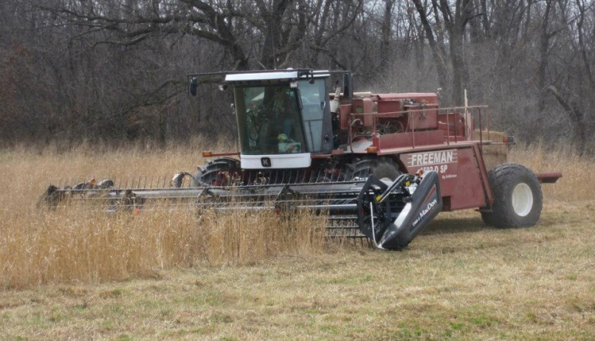
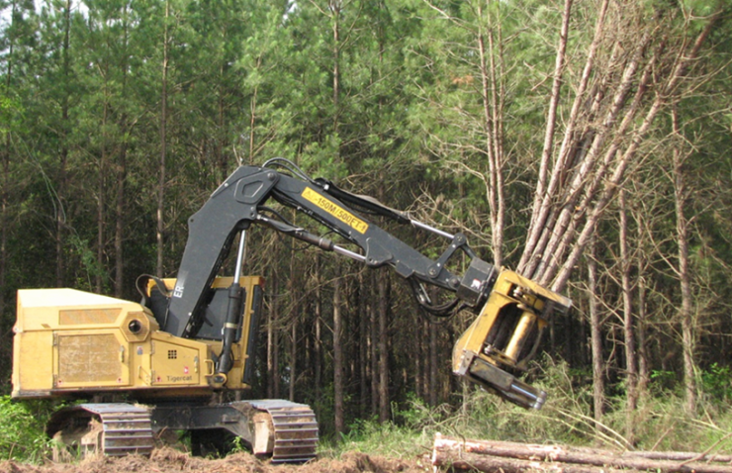
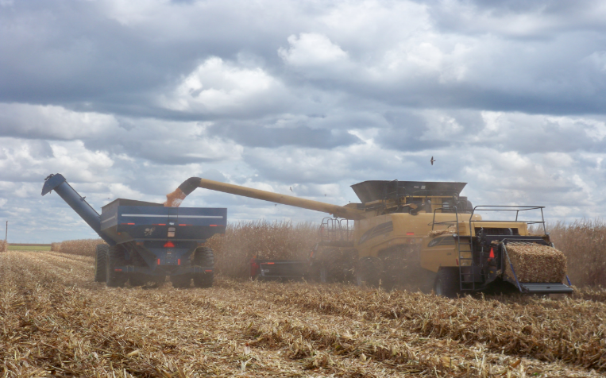
Commercially Available Technologies
Successful project designs from a $21M BETO FOA to reduce feedstock logistics and handling costs are entering the commercial market:
Reduces cost by 25%
Loblolly Pine
Reduces cost by 22%
Corn stover
New self-propelled bailer
New Tiger Cat feller for woody biomass
Reduces cost by 29%
Reduces cost by 34%
Cobs
Corn grain
Stalks
Shrub willows
New single-pass harvester for grain and residues
New self-propelled woody crop harvester design
BETO-funded projects are reducing costs for feedstock logistics
Notes:
Each of these four advanced feedstock logistics technologies was made possible by a BETO FOA, and each design successfully reduces harvesting costs for biomass producers.
These technologies are actually available in OEM catalogues – and in fact – Abengoa, one of our major cellulosic ethanol producers, is employing them today.

Slide 7
Lab & Bench Scale R&D – Aviation Highlights
Focus on biofuels catalyst development at national labs , e.g.:
PNNL - Alcohol to Jet
NREL – DME to branched paraffins
ORNL – dilute Alcohol to Jet
ANL – Catalyst characterization
Focus on industrial partnerships, e.g:
Vertimass
Virent
Lanzatech
Kiverdi
Notes:
Admittedly – BETO R&D efforts have been focused toward light duty vehicle, ie. gasoline, but emphasis started shifting toward the whole barrel replacement
Virent is starting down the jet fuel certification pathway

Slide 8
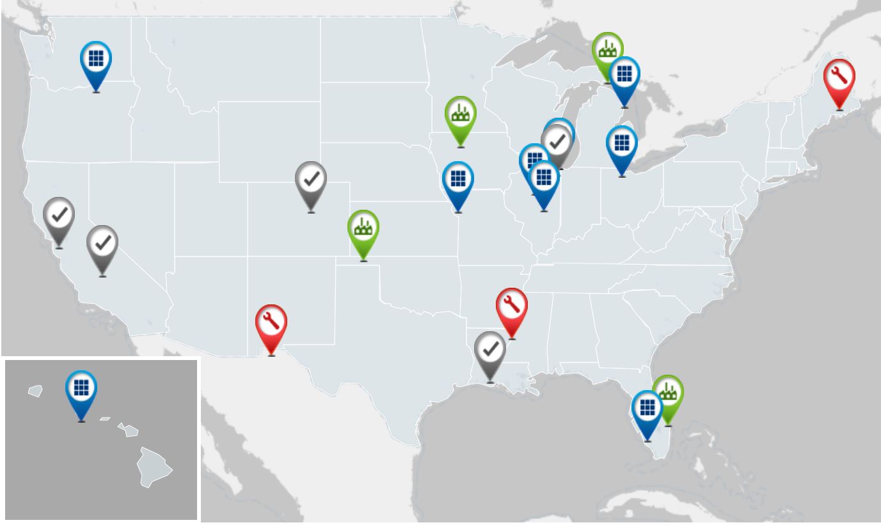
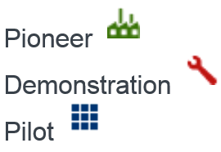
Demonstration Portfolio
The Demonstration and Market Transformation program manages a diverse portfolio of projects focused on the scale-up of biofuel production technologies from pilot- to demonstration- to pioneer-scale.
Solazyme
Algenol
For more information visit: www.energy.gov/eere/bioenergy/integrated-biorefineries
Notes:
iPilots: BioProcess Algae, Frontline, Mecurius
There are 5 Algae projects: Sapphire, Solazyme, Algenol, and BioProcess Algae, Hawaii Bioenergy
Amyris (pilot), Rentech (FT fuels demo)
EtOH Projects as well – notably Abengoa, POET, and INEOs

Slide 9
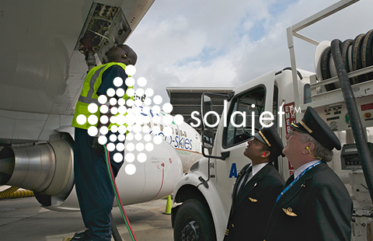
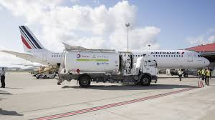
Demonstration Portfolio – Aviation Potential
Several of these have aviation fuel potential
Amyris
Solazyme
Sapphire
Algenol
Bioprocess Algae
Mercurius
Rentech
Frontline
Of course any of the ethanol plants as well via ATJ
Solazyme
BioProcess Algae
Amyris
Rentech
Solazyme
Algenol
Sapphire
Algenol
For more information visit: www.energy.gov/eere/bioenergy/integrated-biorefineries
Notes:
iPilots: BioProcess Algae, Frontline, Mecurius
There are 5 Algae projects: Sapphire, Solazyme, Algenol, and BioProcess Algae, Hawaii Bioenergy
Amyris (pilot), Rentech (FT fuels demo)
EtOH Projects as well – notably Abengoa, POET, and INEOs
Solazyme and Amyris have produced fuels for commercial aviation test flights
2010 Solajet™HRJ-5 Jet Fuel at the World-famous Farnborough International Air Show in UK
Partnered with the Navy as well
Bioprocess algae working on milspec jet

Slide 10
DPA Initiative Goals
In June 2011, Secretaries of Agriculture, Energy, and Navy signed MOU to commit $510M (up to $170M from each agency) to produce hydrocarbon jet and diesel biofuels in the near-term. This initiative sought to achieve:
Multiple, commercial scale integrated biorefineries
Cost-competitive biofuel with conventional petroleum (w/o subsidies)
Domestically produced fuels from non-food feedstocks
Drop-in, fully compatible, MILSPEC fuels (F-76, JP-5, JP-8)
DoD uses approximately 5 billion gallons of fuel annually and represents a key market adopter for advanced biofuels technologies
Navy solicitations via Defense Logistics Agency to purchase biofuel blends through regular procurement contracts as long as they meet cost and performance criteria

Slide 11
DPA Initiative – Accomplishments/Milestones
In May 2013, four projects were selected for Phase I awards with $30M from DoD funds - Phase I was an 18 month effort to accomplish front end engineering design, site selection, and permitting tasks
Successful projects have been selected to go on to Phase II (construction, equipment purchases, and commissioning) if funds are available. A down-select from four to three projects was announced September 2014:
Emerald Biofuels - hydro-treating and upgrading of fats, oils and greases
Fulcrum Brighton Biofuels – municipal solid waste gasification followed by Fischer-Tropsch conversion to jet fuel
Red Rocks Biofuels – forest biomass and wood wastes gasification followed by Fischer-Tropsch conversion to diesel and jet

Slide 12
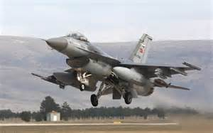
Defense Production Act (DPA) Initiative
In September 2014, 3 projects were selected under the DPA Initiative to build commercial biorefineries to produce:
Drop-in fuels for military applications
Domestic fuels from non-food biomass feedstocks
Cost-competitive biofuels (w/o subsidies)
Production anticipated to begin in 2016/2017
Company | Location | Feedstock | Capacity | Groundbreaking | Off-Take Agreements
 | Gulf Coast | Fats and Greases | 82.0 MM g/y | TBA | TBD
 | McCarran, NV | MSW | 10.0 MM g/y | Fall of 2015
 | Lakeview, OR | Woody Biomass | 12.0 MM g/y | TBA
Interagency initiative to produce more than 100 MM g/y of advanced biofuels
Notes:
At the DOE, we recognize that this is of course a national challenge, and we are committed to working with many different agencies of the federal government to find opportunities to achieve our common goals.
One example, is the Defense Production Act Initiative, which is an inter-agency collaboration between the DOE, the Department of Agriculture, and the Navy.
In 2011, Secretaries from our 3 agencies signed an MOU establishing the initiative and committing to a goal of providing $510 million to support the deployment of commercial biorefineries that will produce drop-in biofuels for military applications – that is renewable diesel and jet fuel.
This past September, 3 projects were down-selected to begin construction on new first-of-a-kind commercial-scale facilities. They are Emerald Biofuels, Fulcrum Bioenergy, and Red Rock Biofuels. Of these, two have already secured off-take agreements with major commercial partners that will purchase these fuels, which will be produced from municipal wastes and woody biomass residues. The third will be producing fuels from waste fats and greases.
DOE is particularly proud of DOE’s investment in technologies used in these projects
Fulcrum uses the TRI gasifier – DOE investment began 3 decades ago with SBIR project
Velocys FT reactor – microchannel reactor has its foundation in research funded by DOE decades ago

Slide 13
DOE Joins Farm to Fly 2.0
We appreciate the hard work in approving alternative fuels and commitment to sustainable growth made by the aviation industry.
DOE is actively committed to accelerating the adoption of alternative fuels by this market.
In 2013, USDA and FAA made a commitment to the aviation industry to help meet their goals with the Farm to Fly 2.0 agreement. This effort seeks to enable the use of commercially viable and sustainable renewable jet fuel in the United States.
In July 2014, Secretary Moniz signed an amendment officially making DOE the newest partner agency in this significant initiative.
Welcome input on specific areas of collaboration for DOE via F2F2
Notes:
Alternative jet fuel production capacity in US will generate jobs and contribute to economic growth.
We’ve also been engaged with the NJFCP that seeks to expedite the certification process through better understanding and modeling of biomass based jet fuel combustion

Slide 14
Questions?

