Slide 1
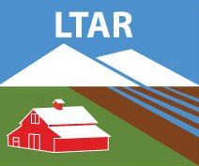

Grass Feedstock Harvests From The Georgia Coastal Plain: Nitrogen Removal
Timothy Strickland, Alisa Coffin, Bill Anderson and Marshall Lamb
USDA Agricultural Research Service

Slide 2
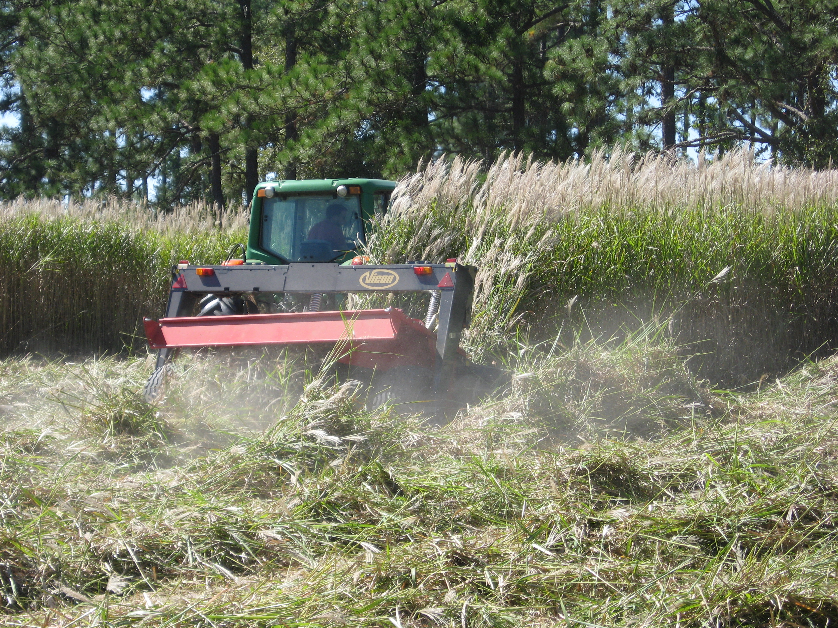
Nitrogen removal of biofeedstock species from experimental plots at Tifton and Shellman Georgia (kg ha⁻¹)
Grass | Low | Medium | High
Giant miscanthus | 22 | 27 | 31
Switchgrass | 16 | 41 | 63
Napier grass | 40 | 100 | 171
Blade Sorghum | 52 (Minimum) | 86 (Median) | 316 (Maximum)
Blade Sorghum DM Yield (Mg ha⁻¹) | 6 (Minimum) | 16 (Median) | 28 (Maximum)

Slide 3
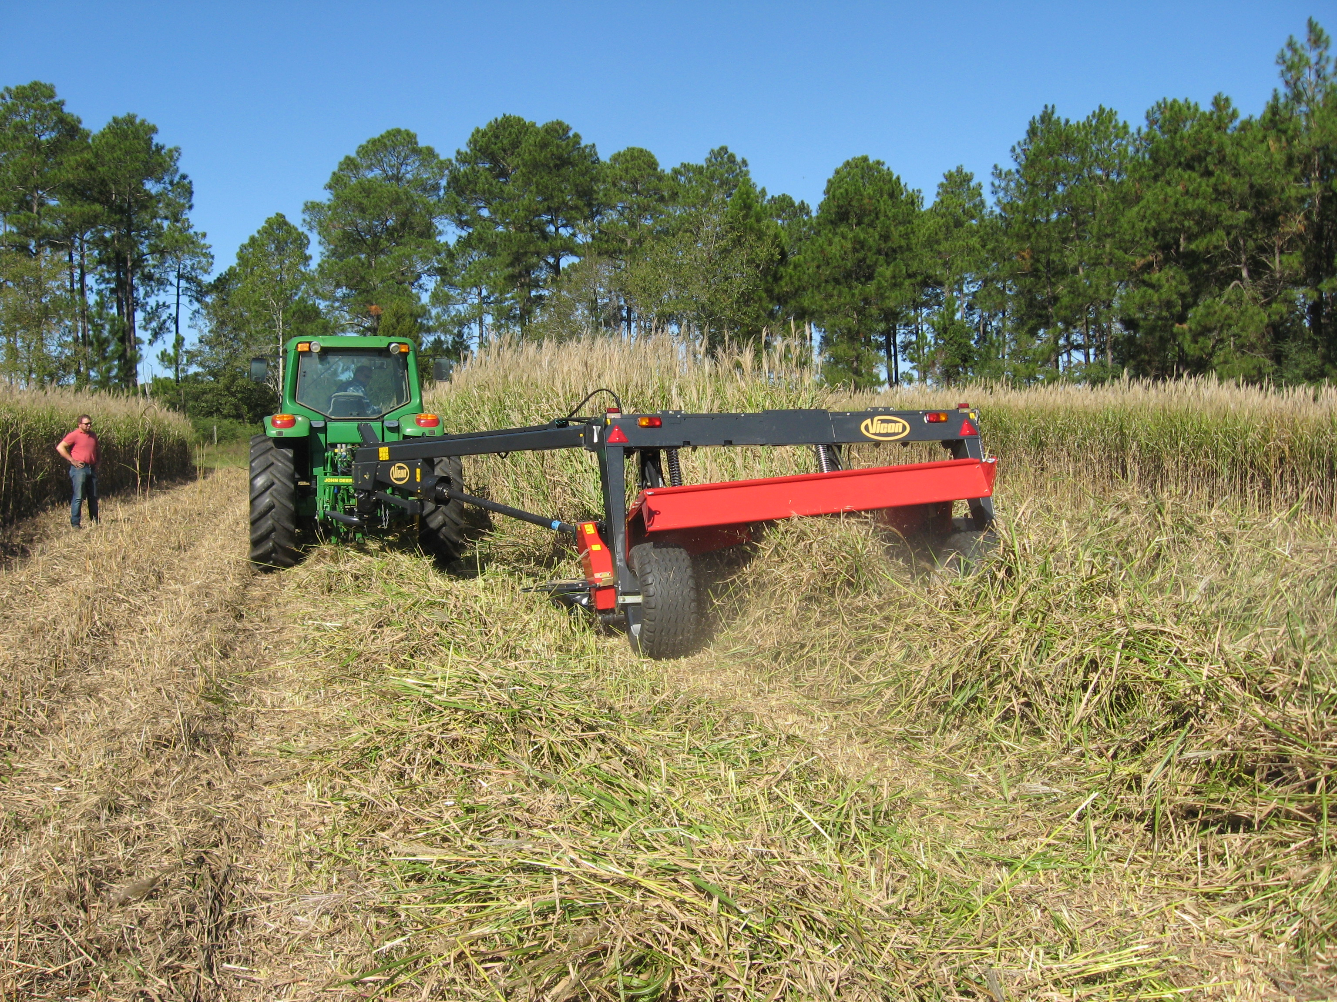
Location, location, location…
Fig. 4 Map showing examples of modeled biofuel zones: RB biofuel zones associated with riparian buffers (a and b); and CW biofuel zones associated with grassed waterways (c and d). Black lines overlain on NAIP 2013 imagery in c and d show RB and CW biofuel zone buffer respectively

Slide 4
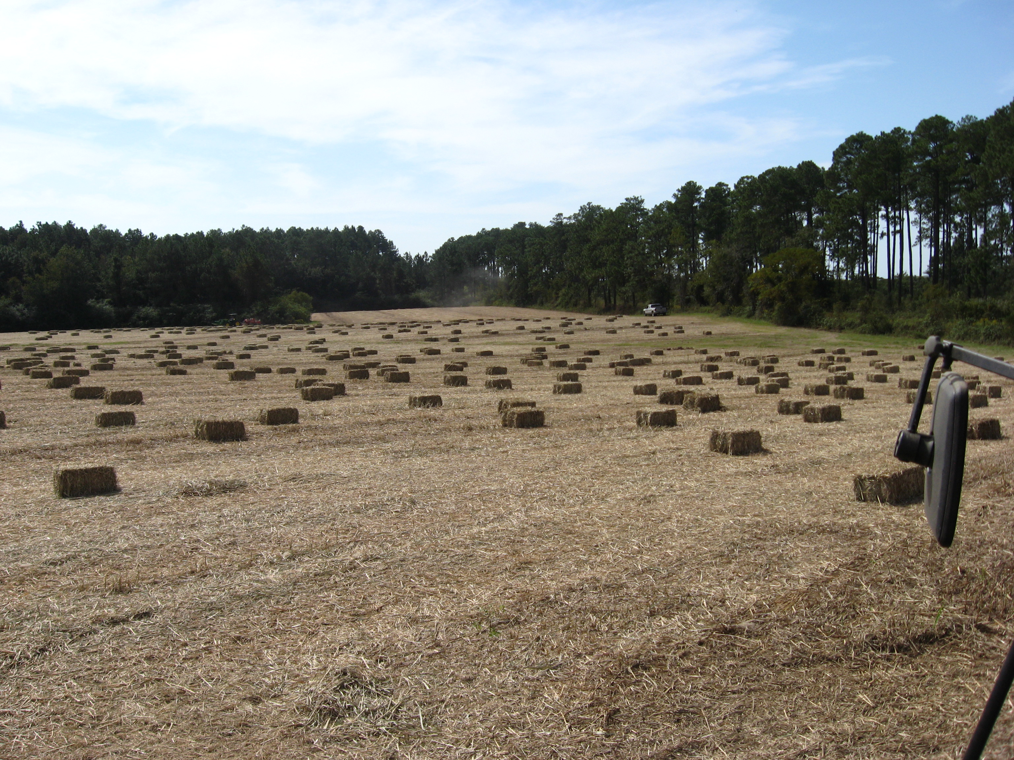
Nitrogen removal potential single species (Mg yr⁻¹)
 | RB biofuel zones | CW biofuel zones | Total
 | (285,140 ha) | (36,520 ha) | (320.860 haª)
Low
Giant miscanthus | 6,270 | 800 | 7,060
Switchgrass | 4,560 | 580 | 5,130
Napier grass | 11,410 | 0^{b} | 11,410
Medium
Giant miscanthus | 7,700 | 990 | 8,660
Switchgrass | 11,690 | 1,500 | 13,160
Napier grass | 28,510 | 0^{b} | 28,510
High
Giant miscanthus | 8,840 | 1,130 | 9,950
Switchgrass | 17,960 | 2,300 | 20,210
Napier grass | 48,760 | 0^{b} | 48,760
ª Overlap area between zones (~800 ha) is removed from total area.
^{b} Napier grass is not included in the yield values for CW biofuel zones because we considered it to be unsuitable for planting in these landscape locations.

Slide 5
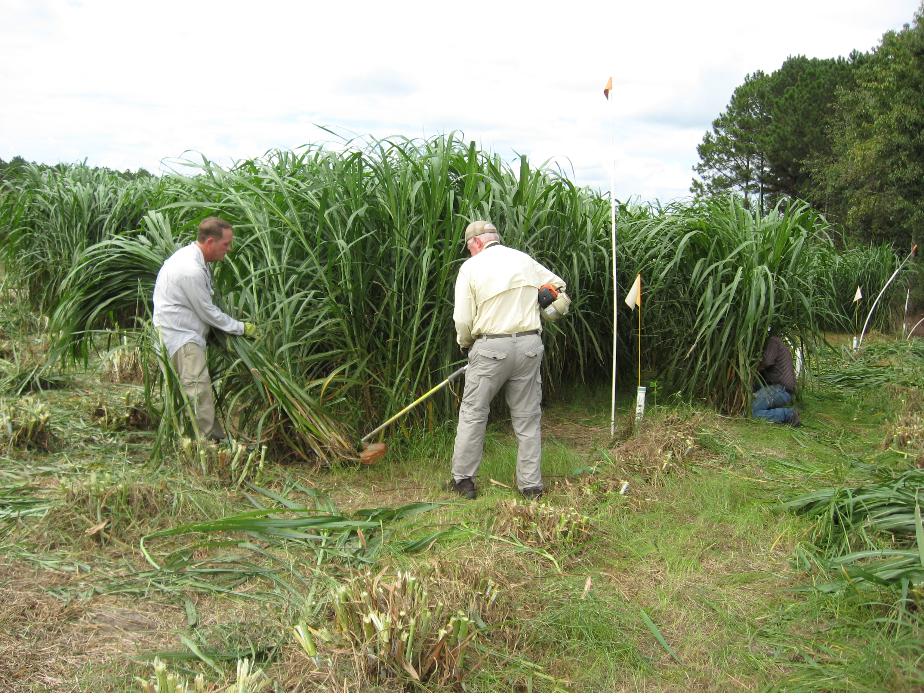
Biomass, N removal and fuel
multi-species strategies
Production strategy | Characteristic | Low | Medium | High
Maximize diversity | Biomass (Tg yr⁻¹) | 2.22 | 4.48 | 6.75
 | N Removal (Mg yr⁻¹) | 8,090 | 17,170 | 26,840
 | Fuel production (Ml yr⁻¹) | 778 | 1,569 | 2,364
Maximize N removal | Biomass (Tg yr⁻¹) | 2.30 | 5.57 | 9.42
 | N Removal (Mg yr⁻¹) | 12,180 | 29,940 | 50,930
 | Fuel production (Ml yr⁻¹) | 805 | 1,950 | 3,296
Maximize yield | Biomass (Tg yr⁻¹) | 2.47 | 5.57 | 9.42
 | N Removal (Mg yr⁻¹) | 7,060 | 29,940 | 50,930
 | Fuel production (Ml yr⁻¹) | 865 | 1,950 | 3,296
Maximize diversity: equal amounts of each biofeedstock in each biofuel zone
Maximize N removal: biofeedstock selected to maximize N removal
Maximize yield: biofeedstock types to maximize DM yield

Slide 6
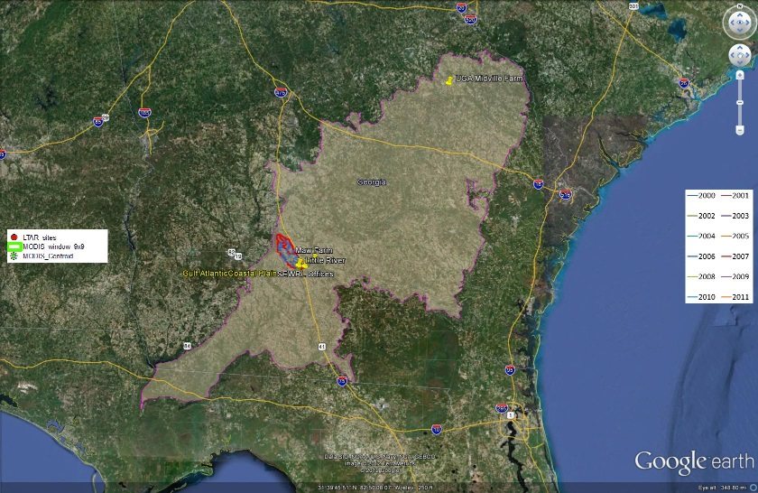
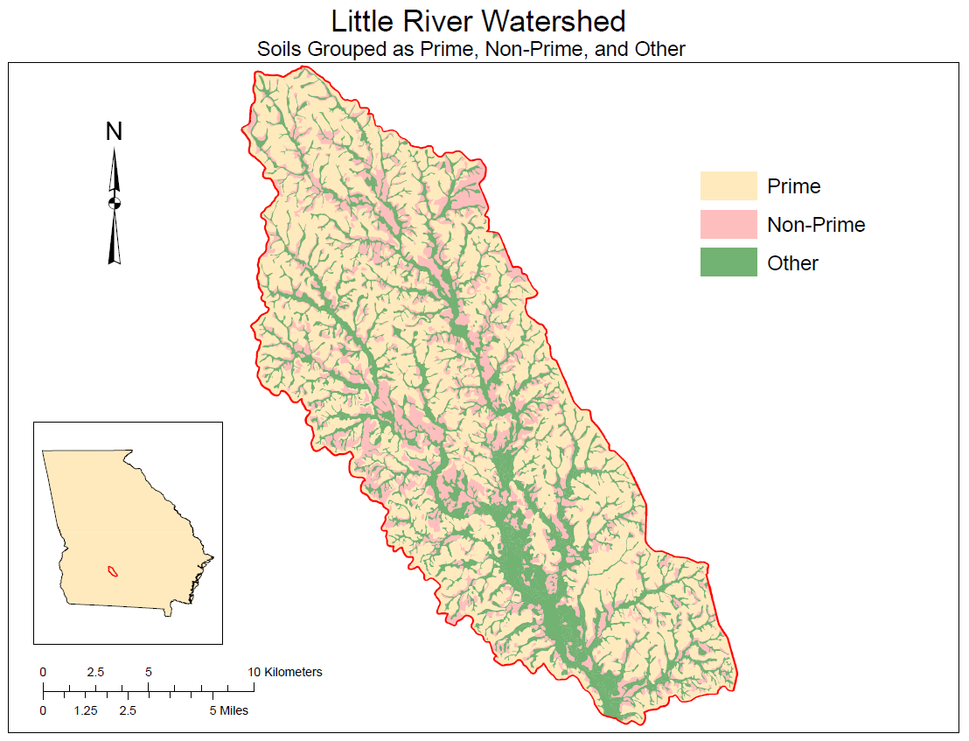
Extrapolating Nitrogen Removal Potential
Notes:
Much, if not all, of the additional acreage needed to supply such conversion facilities could come from lands that are currently planted to crops but considered to be non-prime agricultural lands.

Slide 7
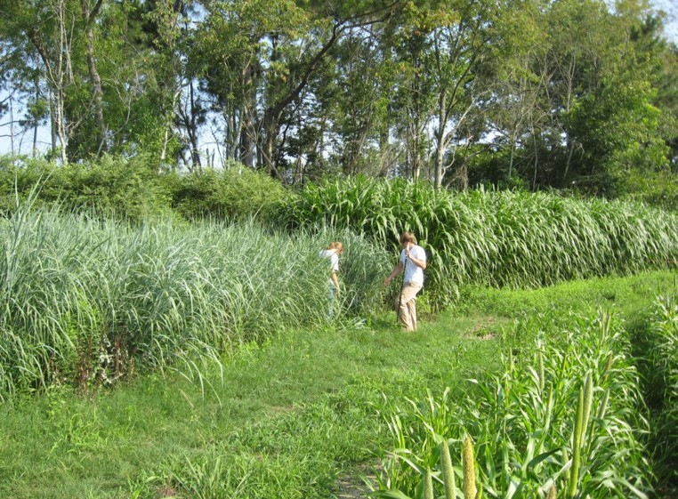
Extrapolating Nitrogen Removal Potential
Avg. LREW NO3-N Flux (kg/ha/yr) | 0.84
Avg. LREW NH4-N Flux (kg/ha/yr) | 0.32
Avg. LREW TKN Flux (kg/ha/yr) | 5.58
EXTRAPOLATING LREW TO COASTAL PLAIN:
Coastal Plain Ag Hectares | 2,392,098
Est. CP Stream NO3-N Flux (kg/yr) | 2,009,362
Est. CP Stream NH4-N Flux (kg/yr) | 765,471
Est CP Stream Inorganic N Flux (kg/yr) | 2,774,834
Est. CP Stream TKN Flux (kg/yr) | 13,347,907
Est. CP Stream Total N Flux (kg/yr) | 15,357,269
Est. CP Stream Total N Flux (Mg/yr) | 15,357
Coastal Plain Biofuels “Maximize N Removal” Scenario (Mg) | 29,940
Potential N Removal Factor | 1.9X
Notes:
By planting perennial grasses in riparian zones, there is also an additional potential advantage of preventing nitrogen runoff from agricultural lands into water ways.

Slide 8
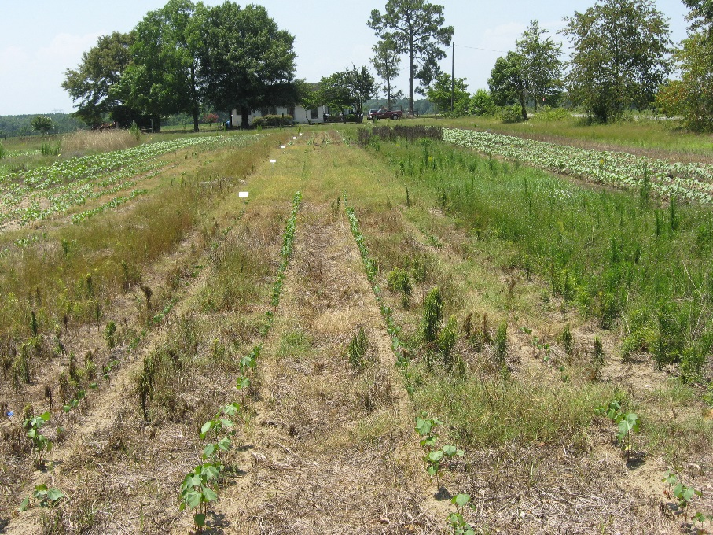
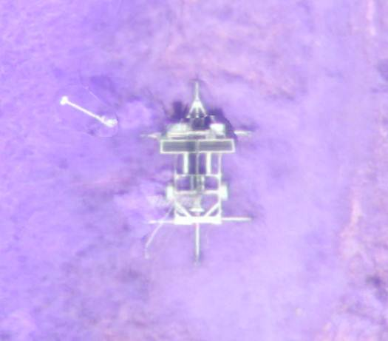
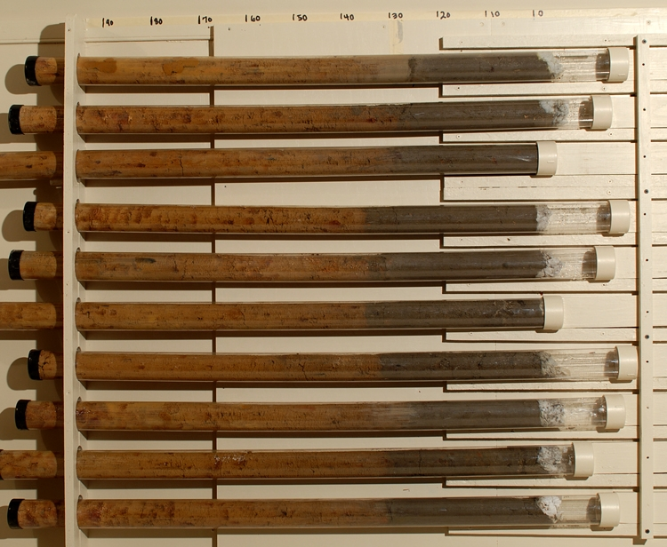
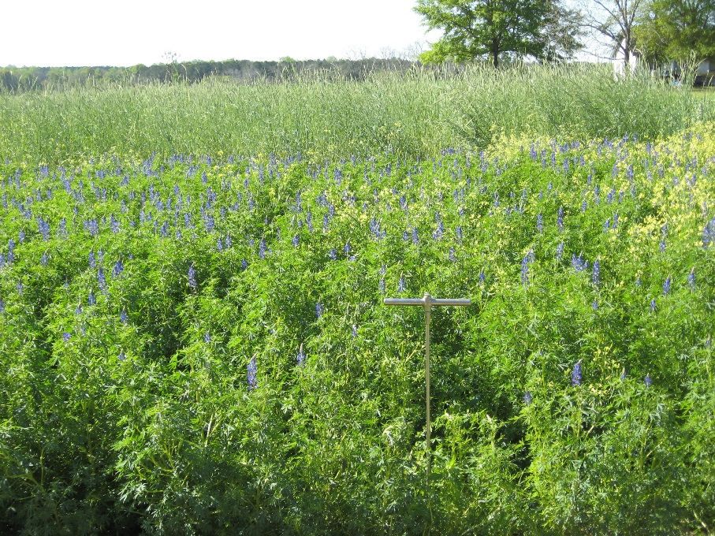
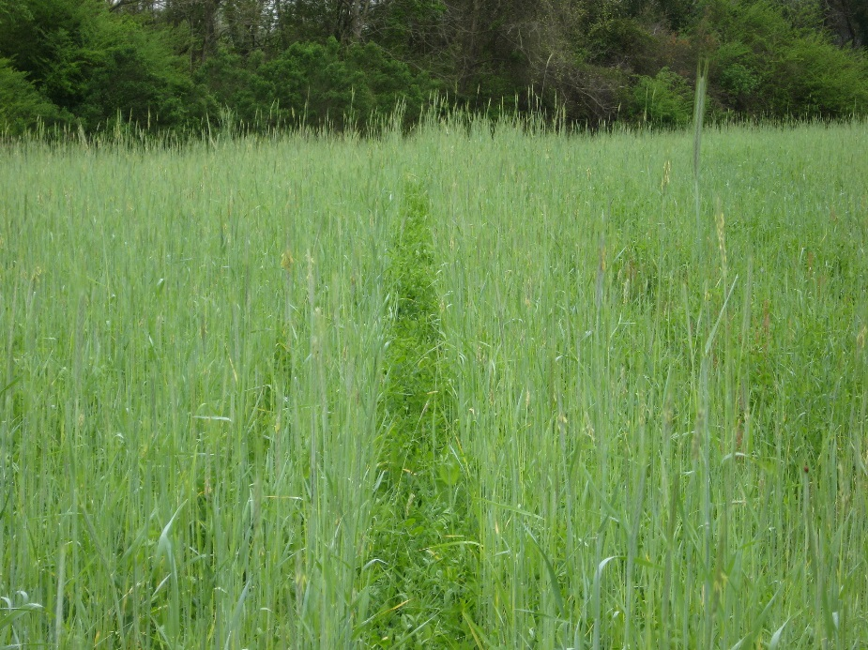
Ongoing Work

Slide 9
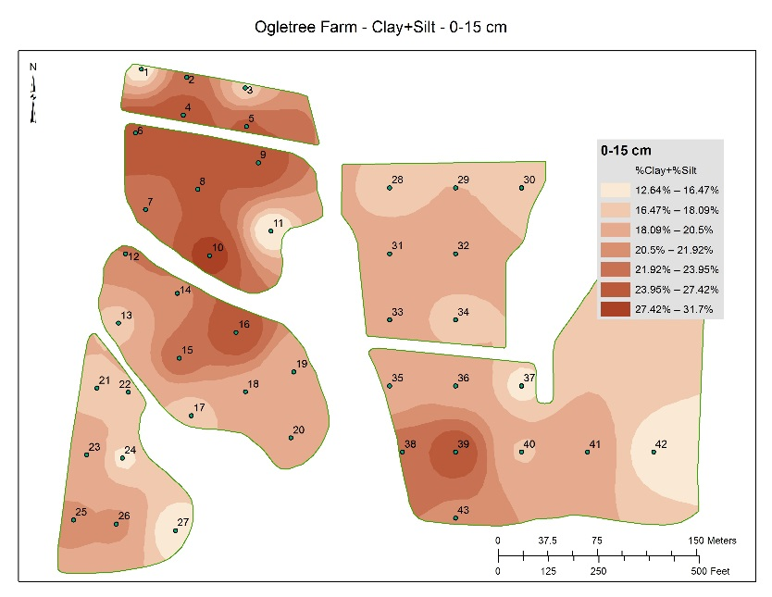
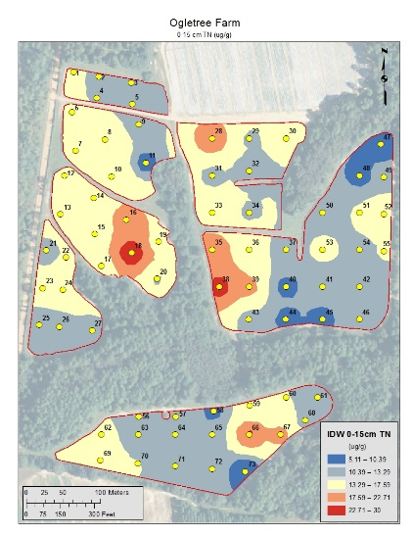
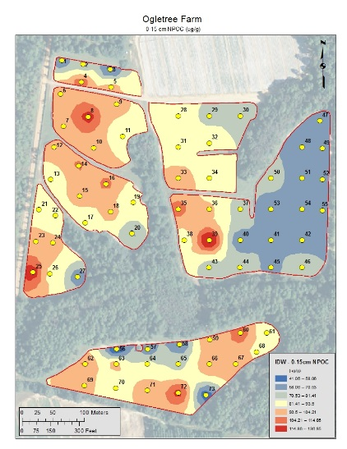
Data Collection
Substrate, Analysis, Strategy | Measurement
Soil | Particle Size Total C&N Labile C&N Bulk Density Water Content
Plant | Dry Matter Harvest Index C-Harvest N-Harvest Trace Elements
Landscape | Elevation Gullies Veg. Cover
Processes | Denitrification WUE NUE
Monitoring | Phenology Energy Balance C Efflux Evaporation Soil Water Soil Temp. Stream Flow Stream Chem. Precipitation
Management | Tillage Fertilization Cover Crops Irrigation Grazing

Slide 10
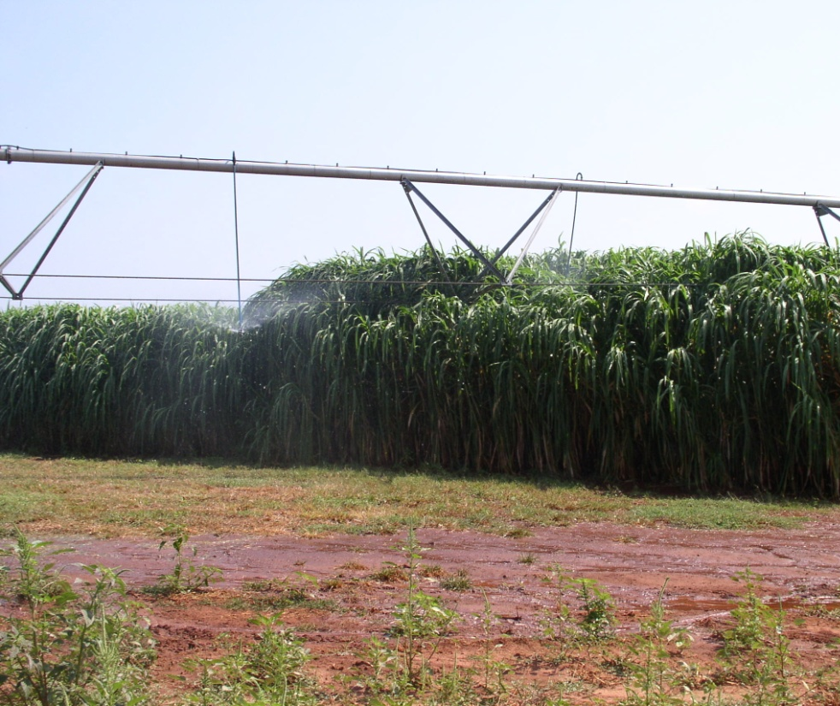
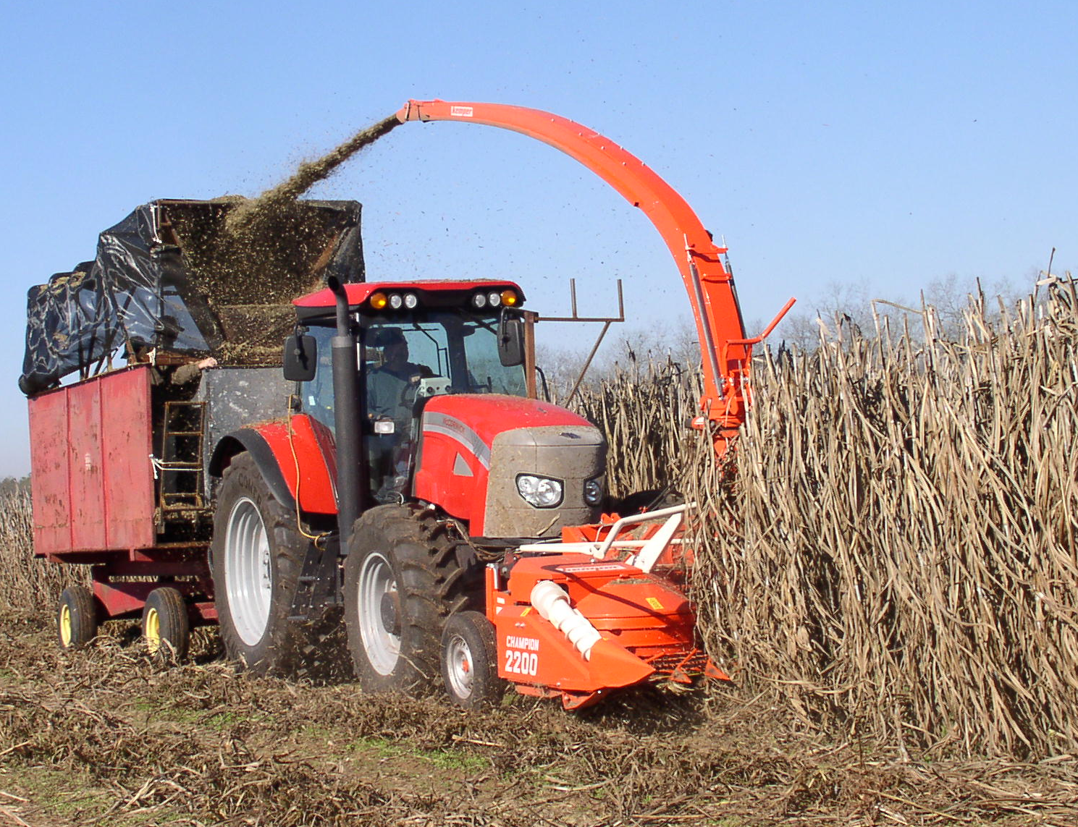
Shellman, GA

