Slide 1
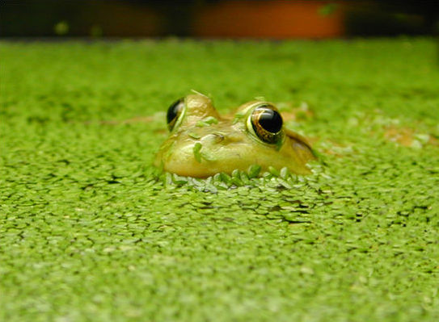
DUCKWEED PROJECT
A Nutritious Solution For Humanity

Slide 2
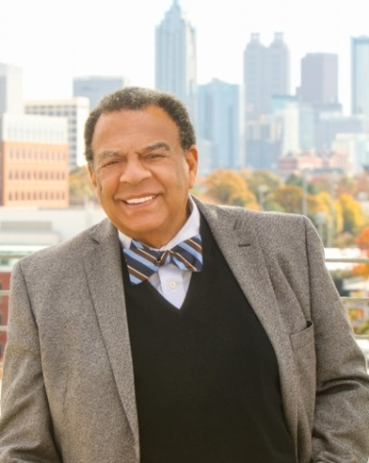
FOREWORD
AMBASSADOR ANDREW J. YOUNG
“Coincidences are Gods Way of Remaining Anonymous”
I first ran into Duckweed in 1992 in Africa working with Law Engineering. While working on a dam located in Uganda I was asked to climb down almost 5 stories into the dam to investigate a couple of tiny, green slime like plants that were clogging and stopping the turbines from generating power. I said to the engineers that were with me, “Something that grows this fast, God has to have a purpose for it.”
It would be 20+ years later that Duckweed would reintroduce itself to me in Louisiana. Freddie Hebert expressed his desire to help alleviate starvation, produce a sustainable energy source, produce ethanol, and assist in cleaning contaminated water ways by utilizing organic protein and ethanol extracted from a fast-growing tiny aquatic plant called Duckweed. I laughed and said, “Coincidences are Gods Way of Remaining Anonymous”.
Freddie is the inventor of a proprietary system used to accelerate the growth of Duckweed and process it to get the high quality protein and a high grade ethanol without using any inorganic ingredients. He said he wanted to help the world with this invention starting in Africa and Haiti.
Looking back on all my experiences in Africa and Haiti, I suggested that he make their first impact with this world changing discovery in the United States, in rural poor farm areas located in Louisiana, Georgia, Alabama, North and South Carolina, and Mississippi, a region of the country that I was very familiar with from the Civil Rights Movement.

Slide 3
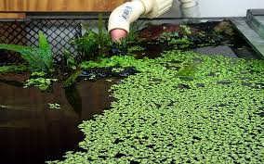
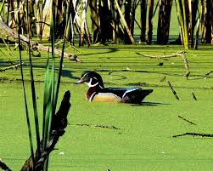
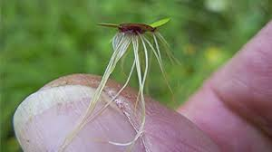
DUCKWEED (LEMNACEAE)
A Nutritious Solution For Humanity
Lemnaceae, commonly known as Duckweed, is a small free-floating aquatic plant that is a huge source of organic protein providing a single solution to address food, energy and water shortages around the globe:
Healthy organic food source solution for animals and humans
Sustainable clean energy source solution
Waste water treatment solution
Sustainable organic direct application fertilizer solution
Affordable, year-round cash crop solution

Slide 4
EXECUTIVE SUMMARY
Andrew J. Young Foundation (AYF) is a community based 501(c)(3) non-profit public charity that supports schools and colleges, YMCA, leadership development programs, producing documentaries through the lens of Ambassador Andrew Young, and furthering of civil and human rights. The foundation has been built upon a philosophy of non-violent change and a belief that unto whom much is given, much is required, which ties The Andrew J. Young Foundation to a deep rooted philosophy of helping others to learn, eat healthy and be equipped to earn a sustainable income, and in turn, to help others. The foundation also supports research and development on new technologies that have the potential to change the existing condition of people living in poverty in America, Africa and across the globe. In this pursuit, the foundation, through the following projects, is currently focused upon finding sustainable solutions for food security and nutrition, job creation, Civil and Human Rights, and financial security. These solutions would empower underserved populations across the US, introducing increased equity and uplifting the quality of life in the society worldwide.
Rural America faces unique challenges in growing its economy and sustaining an educated and healthy labor force. There is a need of training and education that leads to job creation in agriculture and biomass energy. This can be achieved by fulfilling an enormous demand for organic protein for humans, fishmeal, animal feed, biomass energy, and potable water. The Duckweed Project is poised to address these needs.
The Duckweed Project will have small and large-scale community farming impact in rural and urban America. The system to grow duckweed is affordable and allows it to grow at an accelerated rate. It will enable farmers to grow duckweed crop continuously, which when harvested and processed will produce a highly in-demand organic protein and would fill the global shortage of organic protein. Organic protein is used in fishmeal, animal feed, and fertilizers. The products produced from this process will allow farmers to significantly increase their profitability while keeping their costs low.

Slide 5
DUCKWEED – GENERAL INFORMATION
Duckweed is a fast growing, tiny aquatic plant which floats on or just beneath the surface of bodies of fresh water and wetlands. It is the world’s smallest flowering aquatic plant.
Lemnaceae (Duckweed) is a genus of free-floating aquatic plants from the duckweed family. These rapidly growing plants have proven useful as a model system for studies in community ecology, basic plant biology, ecotoxicology, production of biopharmaceuticals, and as a source of animal feeds for agriculture and aquaculture.
Duckweed, once processed, will provide food (human and animal grade protein), energy (bio mass), fuel (ethanol), fertilizer, and help clean-up water.
Duckweed is a vital solution to alleviate starvation, address water contamination and provide clean energy worldwide due to its highly efficient absorption capability of soluble nutrients.
WHAT’S SO GREAT ABOUT DUCKWEED?
Scientists view duckweed as:
A natural wastewater treatment option: This fast growing aquatic plant grows in clean or brackish water. The plant feeds on nitrogen and phosphate organic pollutants, the very stuff treatment plants remove from wastewater.
The world’s “greenest” feedstock: Fast growing, high in protein content and dietary minerals, and easily harvested, the plant is cultivated as a feed supplement for chicken, livestock, and farmed fish, and is ideal for use in developing countries.
An inexpensive, eco-friendly source of ethanol: Unlike corn, duckweed requires minimal human-made energy to grow and doesn’t deplete the human food supply.
A cleaner fuel - While duckweed-produced ethanol, like other plant-based fuels, releases some carbon dioxide into the atmosphere, the plant also absorbs CO2 as it grows.
A sustainable organic direct-application fertilizer - In soil or aquaponics farming, this organic fertilizer makes the soil or water nutrient rich, transforms unhealthy soil or water, and corrects nutrient imbalances.

Slide 6
MARKET CHALLENGE AND SOLUTION
Challenge with growing Lemnaceae (Duckweed)
The high cost to fertilize duckweed inorganically has made it prohibitive to grow it commercially for producing protein concentrate and ethanol for market demand.
Solution to growing Lemna Duckweed
The proof of concept phase showed that it is possible to fertilize duckweed in a self-sustaining way at an affordable cost. This unique fertilizing method is anticipated to increase duckweed’s growth rate from 30 tons/acre/year to 75 tons/acre /year.
Protein concentrate is produced by using the corn ethanol process to remove the starch from duckweed leaving a concentrate of 61% protein and 8% lysine behind. Recycling of the yeast water, after ethanol and solids are removed, to the duckweed growing area makes it possible to grow the duckweed twice its normal size with no outside nitrogen. Duckweed doubles its weight every 24 hours and this process is 100% organic.

Slide 7
Key Solutions
Duckweed
Organic Fertilizer
Organic Protein
Waste Water Treatment
Ethanol
Biomass Electricity
Regional Growers

Slide 8
BENEFITS OF ORGANICALLY PRODUCING DUCKWEED
Affordable Food Source:
The vast quantities of human and animal grade protein that can be produced will address the food needs of our growing population and help alleviate starvation and malnutrition worldwide
Organically grown Lemnaceae (Duckweed) once processed will offer a healthy food protein source for humans and animals.
Organic protein selling price of $1,200/ton is equivalent to soy meal’s selling price of $1,228/ton:
Fish Meal replacement’s value is currently above $2000 per ton
Benefits of Duckweed as an Alternative Fuel Source:
Produces more starch per acre than corn
High starch and low lignin—is ideal for ethanol production
Produces biofuel without waste
Does not compete with land crops, grows rapidly, and is easily harvestable.
Affordable Energy Source:
Ethanol produced from duckweed cost $0.52/gal. versus ethanol produced from corn that cost $1.75/gal.+ ($1.23 savings using duckweed)

Slide 9
PROJECT OBJECTIVES AND IMPACT
Project Objectives
The overall objective of the project is to increase food production and diversification of existing farming processes by introducing duckweed as a cash crop for the farmers and a rich organic protein for nutrition worldwide.
Special Objectives
To increase the production of duckweed crops
To produce high-quality organic protein for fishmeal in large quantities to cater to global rising demand
To increase farmers’ profitability by introducing new in-demand cash crops
To teach farmers how to create sustainable agriculture production systems
To produce anhydrous ethanol at a substantially lower cost without any inorganic waste
To produce educational and training materials
To create jobs by introducing a replicable fertilizing/growth closed loop processing system
To create sustainable food and energy systems
Project Impact
Impact on Environment
Production of Duckweed will help to reduce the following environmental hazards:
Smog from coal and ethanol (corn produced) burning plants that emit green house gases
Depletion of the forest and tree cover, due to demands for fuel wood and timber activities which have increased run-off and soil erosion, especially on derived watersheds leading to loss of soil nutrients, impacted waterways and damage to fisheries
Project Replicability
This project when fully implemented will serve as a model/ pilot project that could be replicated in other areas of the country and around the globe.
Role of Farmers
Integration of the farmers into mainstream development once the project is completed. Training/Education programs will be provided to help farmers’ expand their knowledge base and skillset to take advantage of the multitude of business opportunities available from growing duckweed.

Slide 10
DUCKWEED PROJECT
Pilot Plant
This phase of the project is located in Gueydan, Louisiana on 2.5 acres.
This facility demonstrates the fully integrated processes of the Duckweed processing system. Additionally, the facility enables the full evaluation and development of the process as well as the start-up, shut down and normal operating procedures.
The facility provides valuable operability data that will feed into the larger full-scale commercial plant. In addition to the future use of the pilot plant as a training facility for customer operative training, it will also serve as a tour facility.
A third party engineering firm will perform the scalability study to scale the pilot plant.

Slide 11
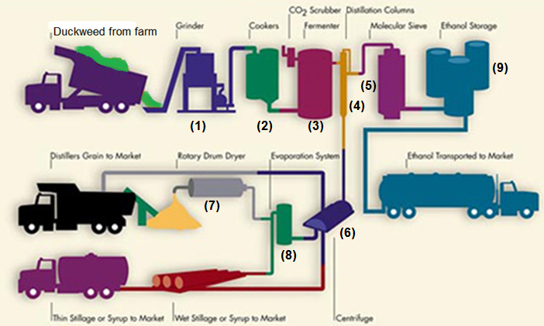
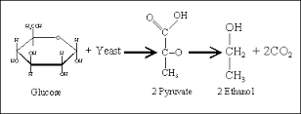
ETHANOL PRODUCTION FROM DUCKWEED
Key
Grinder
Cooker
Fermenter
Distillers
Molecular Sieves
Centrifuge
Rotary Drum Dryer
Evaporating System
Ethanol Storage
Repaired Process Building (Lab)

Slide 12
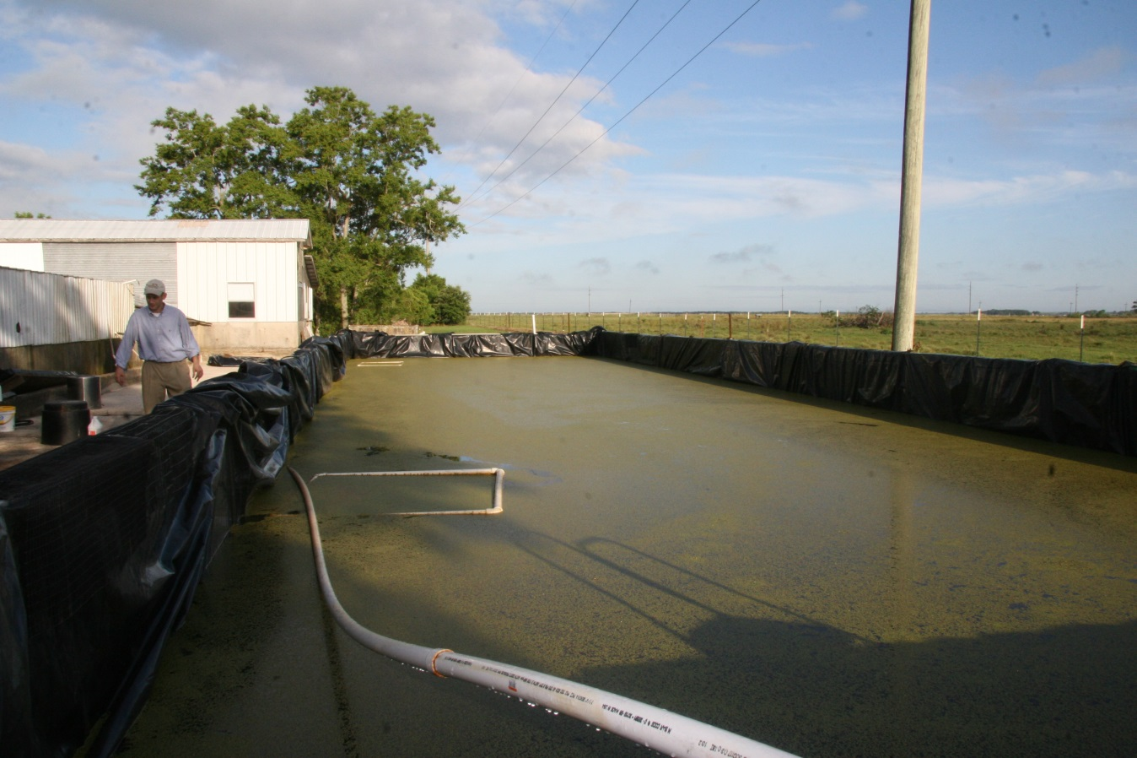
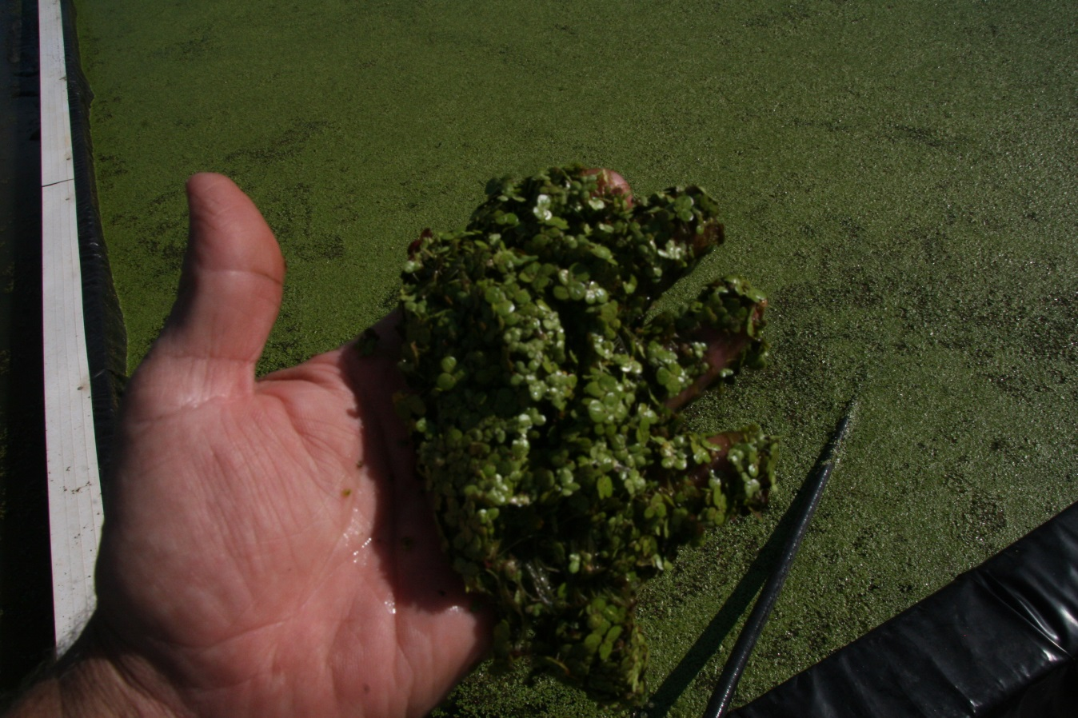
Primary Lagoon Duckweed Growing Area
Day #1
Duckweed Day #1

Slide 13
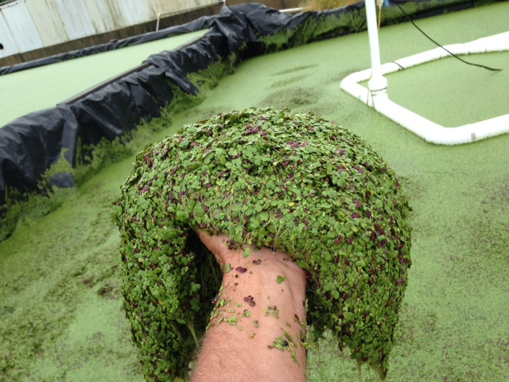
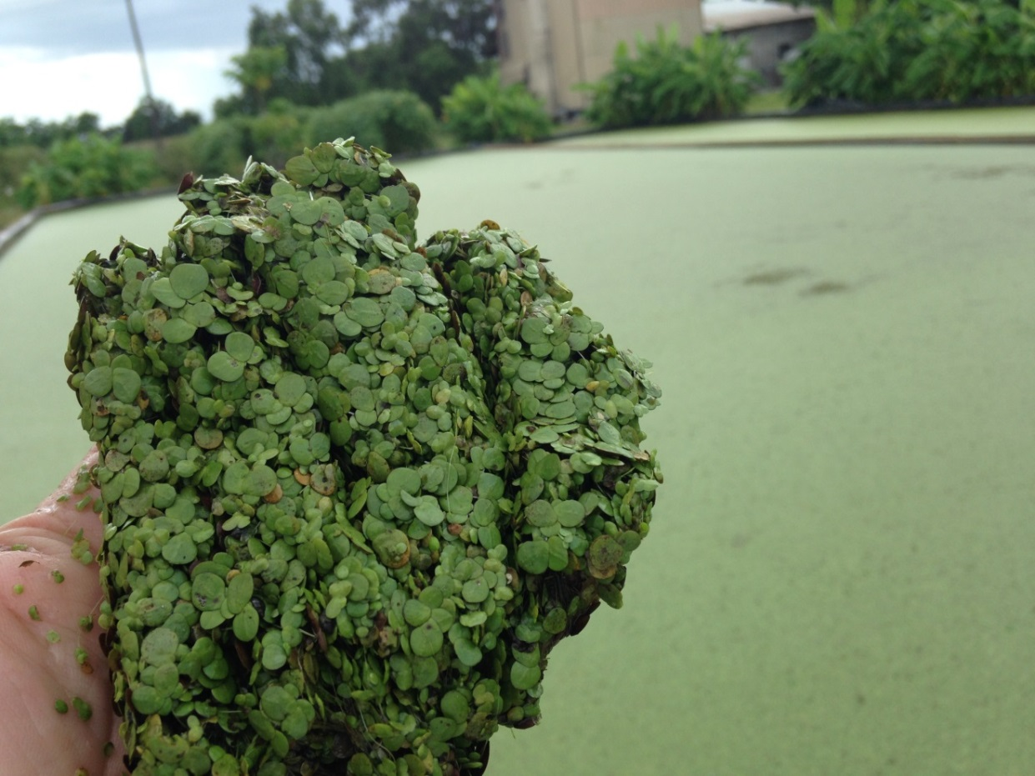
Nutrient Rich Duckweed
Day #2 (Left)
Nutrient Rich Duckweed
Day #3 (Right)

Slide 14
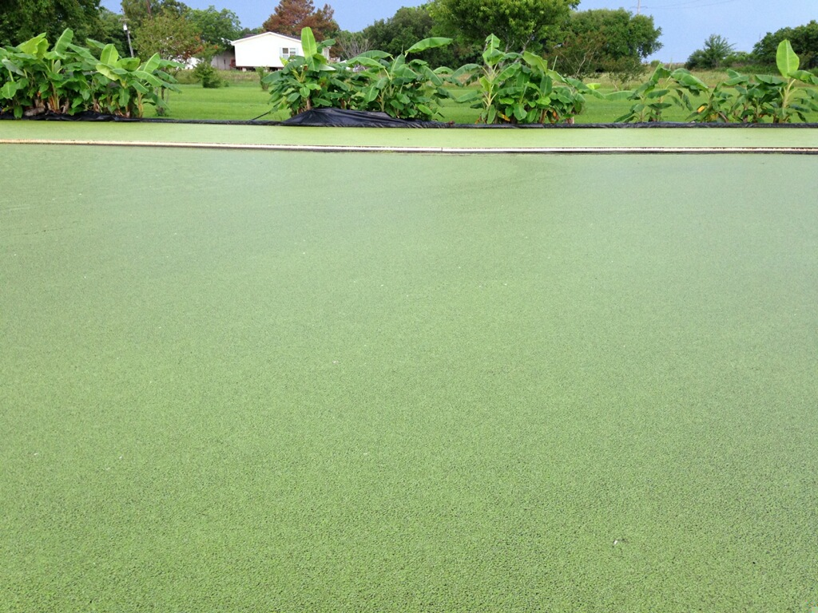
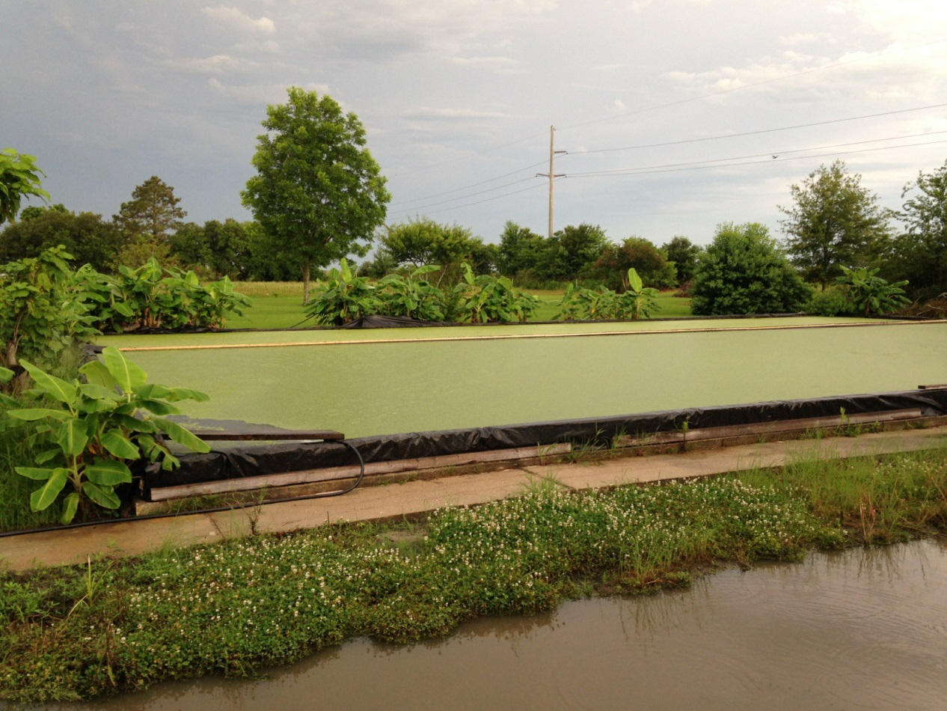
Duckweed Growing Area Lagoon #2
Lagoon #2 Duckweed growth multiplied by adding sustainable organic fertilizers

Slide 15
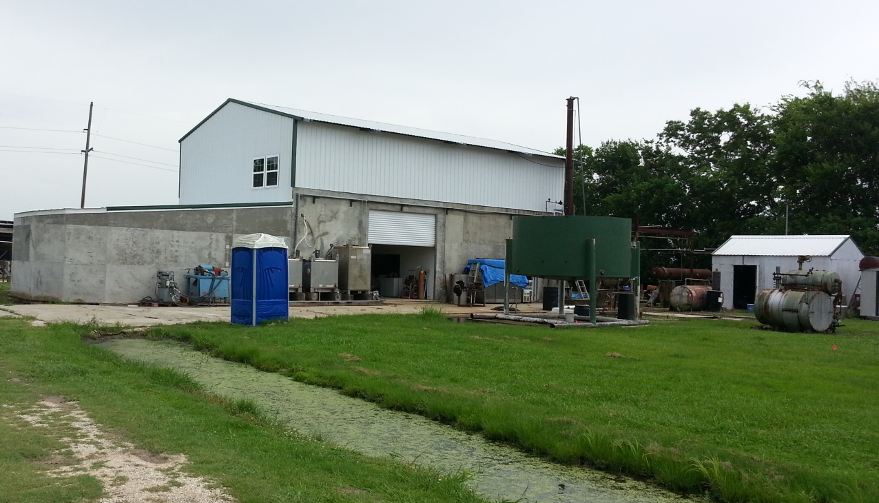
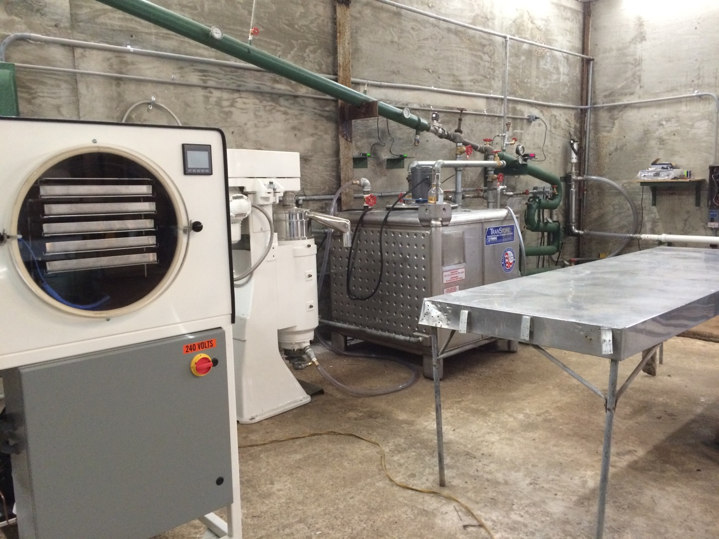
Pilot Plant
(New Construction)
Pilot Plant process line

Slide 16
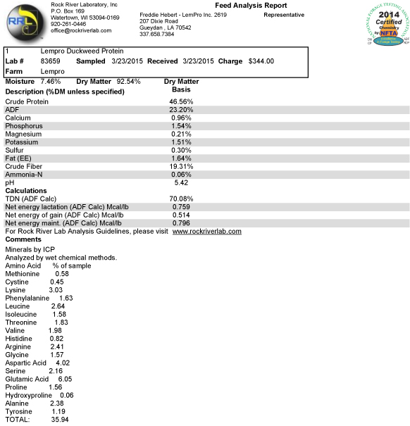
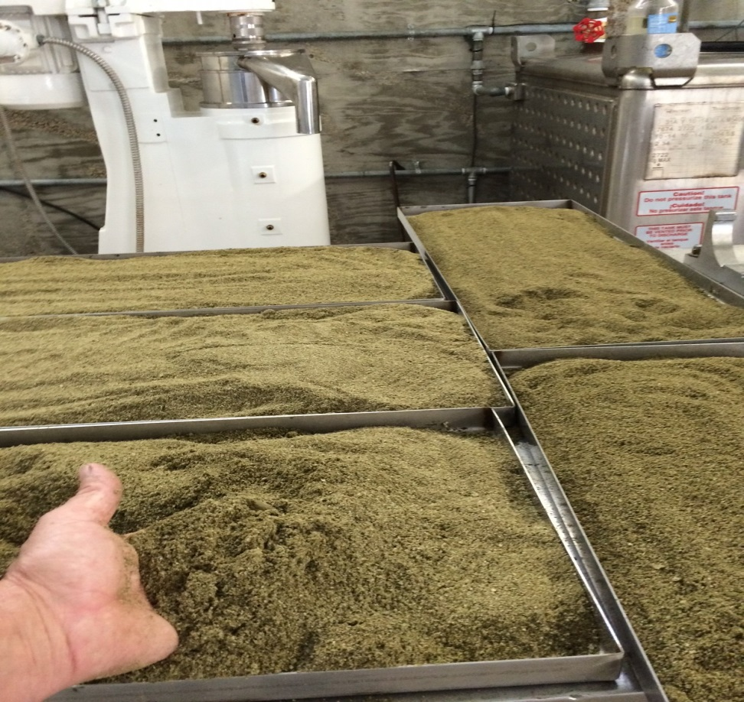
LAB TEST REPORT OF DUCKWEED PROTEIN CONCENTRATE
Note: The results of this Feed Analysis Report reflects early stage testing, which is equal to or greater than comparable organic protein concentrates on the market. We are hopeful this processing method will ultimately produce results of 50% - 61% protein concentrate which will be one of the highest quality proteins in the industry.

Slide 17
DUCKWEED PROJECT
ETHANOL
Quality of ethanol depends on the speed of fermentation process.
Slow fermentation leads to formation of vinegar and reduces the proof of ethanol.
We have produced fuel grade ethanol from duckweed with two distillation columns.
With the difference in boiling points of ethanol (176°F) and water (212°F), the azeotrope mixture is 190 proof containing 95% ethanol and 5% water.
We would like to produce the anhydrous ethanol by adding the second membrane and a vacuum pipe that could extract out the water molecules.
There is a possibility of producing regent ethanol from duckweed by adding a third distillation column, but we haven’t tried that yet.
The system gives 10 gallons of ethanol per pound of dry protein powder.

Slide 18
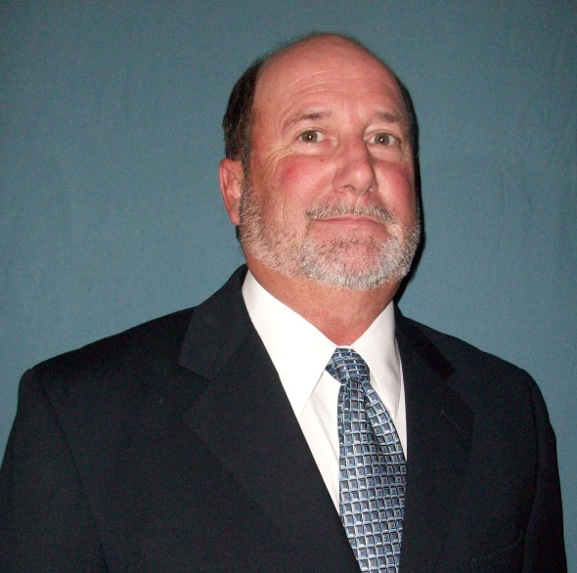
Freddie Hebert - Bio
Freddie Hebert, an inventor and a thinker, is the lead technical force behind the Duckweed project who has been a licensed Ethanol producer since 1979. He learned to make ethanol at an early age by working with his grandfather in West Virginia. Freddie learned to build refineries working with his father, a superintendent who built refineries in Lake Charles, Louisiana.
Freddie is a gifted technician and tradesman. He has experience in building homes, farming, and general repair and building maintenance.
In 1979, when Jimmy Carter was in the office, he sent farmers a book called Fuel From Farms . This book, coupled with the gas spike, and his family experience working with ethanol inspired Freddie to enroll in an Ethanol production course in Colby, Kansas. Freddie has been producing Ethanol out of a number of Louisiana Feedstock for the last 35 years. He won the National Energy Award in 1992 for a farm energy demonstration Project where he produced electricity using Methane.
Freddie has been a leading duckweed expert and helped support the expansion of research with this cash crop for over 20 years. Freddie’s ground-breaking research for creating a proprietary rapid affordable growth process for producing duckweed is poised to change the future for farmers in the US, and help eradicate hunger around the globe.

